Slide 1
A3 Specific Responsibilities of people working in H&SC
Starter Task:
What do you think we expect from you in your role as a trainee nurse?
Holy Cross College Hospital
NHS Foundation Trust
May 2018

Slide 2
Learning objectives…
By the end of this section, you will be able to:
Identify the specific responsibilities of those working in H&SC
Discuss how legislation, policies and procedures would apply to you in your role as a trainee nurse
Apply these specific responsibilities to our case studies

Slide 3
Introduction
People working in health and care settings are required to work to high professional standards.
They are required to follow agreed policies and procedures and actively promote the health and wellbeing of those in their care.
The Care Sector Consortium (1992) established a care value base, which covers the following principles…

Slide 4
Specific responsibilities
Task:
Discuss what you had written down in the first activity with the person sitting next to you.
Compare your notes to the principles that are on the board. Are there any similarities?
Add any additional notes that you do not have in your workbook.
Promoting anti-discriminatory practice to ensure that care services meet the needs of all people, regardless of their religion, culture, ethnic background, disability or other personal differences
Empowering individuals, enabling them to take control of their lives and care decisions
Ensuring the safety of staff and service users
Maintaining confidentiality and privacy
Promoting good communication between carers and between carers and their clients

Slide 5
Health and care professions
The care principles can be found in the code of practice of all health and care professions.
Task:
In your workbook, see if you can identify the health and care professions and their role within the table.
Notes:
Answers on next slide – discuss with students after debriefing activity.

Slide 6
Health and care professions
GMC – General Medical Council
Sets and monitors standards of behaviour for doctors.
Notes:
Questioning during debrief could include – what standards of behaviour might be expected of a doctor? Could this differ from other health care professionals? If so, how?

Slide 7
Health and care professions
NMC – Nursing & Midwifery Council
Sets and monitors standards of behaviour for nurses and midwives
Notes:
Questioning during debrief could include – why do you think there are different councils for doctors, nurses and midwives? How could this benefit the professions?

Slide 8
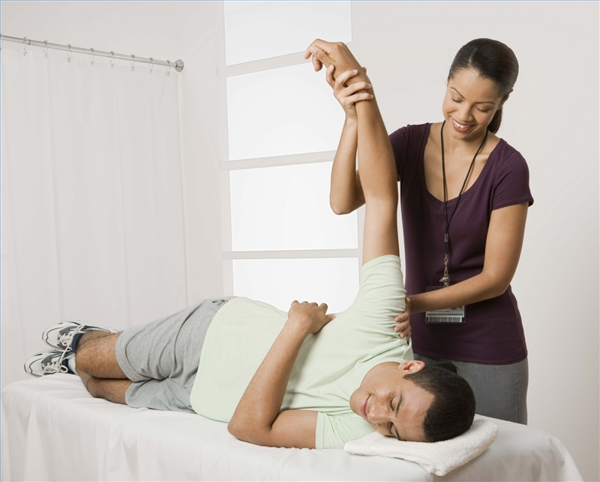
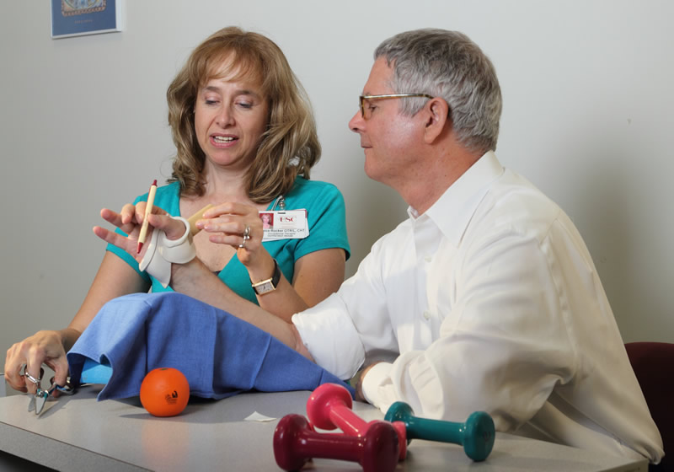
Health and care professions
HCPC – Health and Care Professions Council
Sets and monitors standards of behaviour for social workers and for a range of other health professions such as…
Notes:
Physiotherapists
Occupational therapists
Paramedics
Speech Therapists

Slide 9
Promoting anti-discriminatory practice
Anti-discriminatory practice is a core value and principle that guides the work of health and care professionals.
The legislation that this is based on is…
Equality Act
2010

Slide 10
Promoting anti-discriminatory practice
Anti-discriminatory practice aims to ensure that the needs of service users are met, regardless of any protected characteristics and that any prejudice by staff or other service users are appropriately challenged.
Task:
There are 9 protected characteristics. What do you think these are?
Record your answers in your workbook.
Notes:
Answers on next slide.

Slide 11
Protected characteristics
The 9 protected characteristics are…
Age
Disability
Gender reassignment
Marriage and civil partnerships
Pregnancy and maternity
Race
Religion or belief (including lack of belief)
Sex
Sexual orientation
Notes:
Debrief discussion if there are any that students are unsure of, e.g. gender / sex / sexuality.
Discuss what this means in practice for students – how could they apply this knowledge in their roles? Would it make them act differently towards anyone? If so, how / why?
Students to add these into their workbooks.

Slide 12
Human Rights Act (1998)
The Human Rights Act (1998) applies to all parts of the United Kingdom (England, Scotland, Wales and Northern Ireland).
It guarantees rights to people cared for by ‘public authorities’ to be treated with fairness, dignity and respect.
Task:
Consider what each of the rights actually mean and make notes in your workbook.
Notes:
Students to discuss in pairs / small groups each of the rights and make notes on what they mean to them as individuals.
There is not necessarily a right / wrong answer here, but this is getting students to think about applying it to themselves and then they can consider other people.
Do not rush this, as students may need time to consider what aspects such as ‘liberty and security of person’ actually mean.
If required, they can complete some research on their phones / laptops.

Slide 13
Anti-discrimination in practice
The Human Rights Act guarantees rights to people cared for by ‘public authorities’.
Task:
Can you think of any examples of public authorities?
How do you think you would treat our service users with fairness, dignity and respect in your role as a student nurse?
Notes:
Public authorities include hospitals, GP practices, social service departments, schools and colleges and many care and nursing homes.
There is no right or wrong to the second part of this task – students are considering their own practice and applying these principles to the case studies. They should be guided to use their Book 1’s and consider the holistic needs of the individuals.

Slide 14
Adapting provision for SUs
Despite the legislation that underpins the policies, procedures and codes of practice governing professional practice and the care provided in health and care settings, the world is not free from prejudice and discrimination.
Think Higher:
If we have legislation that aims to prevent discriminatory practice, why do you think that unfair treatment is a daily experience for some people within society?.
Task:
What is prejudice and discrimination? Discuss with the person sitting next to you.
Prejudice
Preconceived opinion (thought)
Unfair treatment of someone else based on characteristics (action)
Discrimination
Notes:
Prejudice is the thought about another person (often unjustified).
Discrimination is the action taken based on this prejudice / thought.
Students to write this down in their workbooks after considering what prejudice and discrimination could be, including any examples. There is no right or wrong here, but looking for things such as:
Disabling environments
Prejudice from society
People not being educated in different types of disabilities or other protected characteristics

Slide 15
Land of the Nutritios
activity
Notes:
Question has been taken from the Sample Assessment Paper.
Teacher could peer assess or collect booklets in to mark at the end of lesson.
Answers will be credited according to the learner’s demonstration of
knowledge and understanding of the material using the indicative
content and levels descriptors below. The indicative content that
follows is not prescriptive. Answers may cover some/all of the
indicative content but should be rewarded for other relevant
answers.
Answers might refer to the need to:
• be able to sign British Sign Language (BSL)
• be able to assess the living environment of someone who has a
hearing impairment and make recommendations for
change/improvement
• have knowledge of the technology available
• have knowledge of the allowances available to people with
hearing impairments, e.g. Personal Independence Payments
(PIP)
• be familiar with relevant government schemes
• utilise their communication skills effectively
• understand the impact of hearing impairment on the individual,
which might cause
o communication difficulties
o social isolation
o mental ill health
• recognise how to spot the signs of decreasing ability to hear,
which might be
o a need to have statements repeated several times
o having a TV/radio at a high volume
o failure to react to other people.
Award marks for any other valid responses.
1 1–3 • Limited generic knowledge not applied to the context of the
question.
• Points raised are not interlinked and presented as a list.
• Answer is unbalanced with limited number of aspects of the
scenario considered.
2 3–4 • Accurate knowledge but not always applied to the context of
the question.
• Some points are explained and interlinked.
• Answer considers a number of aspects of the scenario, but
they may not be given appropriate weight.
3 5–6 • Accurate knowledge applied consistently to the context of
the question.
• Points are interlinked and explanation is coherent.
• Answer is balanced with weight given to range of aspects of
the scenario.

Slide 16
Eye on the exam…
Read through the scenario and attempt the exam question below.
Notes:
Question has been taken from the Sample Assessment Paper.
Teacher could peer assess or collect booklets in to mark at the end of lesson.
Answers will be credited according to the learner’s demonstration of
knowledge and understanding of the material using the indicative
content and levels descriptors below. The indicative content that
follows is not prescriptive. Answers may cover some/all of the
indicative content but should be rewarded for other relevant
answers.
Answers might refer to the need to:
• be able to sign British Sign Language (BSL)
• be able to assess the living environment of someone who has a
hearing impairment and make recommendations for
change/improvement
• have knowledge of the technology available
• have knowledge of the allowances available to people with
hearing impairments, e.g. Personal Independence Payments
(PIP)
• be familiar with relevant government schemes
• utilise their communication skills effectively
• understand the impact of hearing impairment on the individual,
which might cause
o communication difficulties
o social isolation
o mental ill health
• recognise how to spot the signs of decreasing ability to hear,
which might be
o a need to have statements repeated several times
o having a TV/radio at a high volume
o failure to react to other people.
Award marks for any other valid responses.
1 1–3 • Limited generic knowledge not applied to the context of the
question.
• Points raised are not interlinked and presented as a list.
• Answer is unbalanced with limited number of aspects of the
scenario considered.
2 3–4 • Accurate knowledge but not always applied to the context of
the question.
• Some points are explained and interlinked.
• Answer considers a number of aspects of the scenario, but
they may not be given appropriate weight.
3 5–6 • Accurate knowledge applied consistently to the context of
the question.
• Points are interlinked and explanation is coherent.
• Answer is balanced with weight given to range of aspects of
the scenario.

Slide 17
Specific needs
TASKS:
Walking around college, can you identify anything that may be an adaptation to meet the needs of people with specific needs?
Considering your service users, how do you think that health and care provision could be adapted to meet their needs?
Notes:
Students could complete the first task by actually going out of class for 10 minutes to walk around, or discuss this in groups. This activity could also be set as pre-work.
Students to work through each of their case studies (they will need book 1 t

Slide 18
Empowering individuals
The importance of fostering and supporting the empowerment of service users can often be overlooked.
Empowerment:
Supporting people to take control of their lives and futures by taking a full part in discussions and decisions about their care and treatment.
Task:
How do you think you could help to empower service users in your role as a trainee nurse?
Notes:
See if students can guess what empowerment means. This could be run as a mini-whiteboard activity (think, pair, share), or as individual and then small groups, with the group deciding ‘best on desk’ definition before teacher reveals the actual definition.

Slide 19
Empowering individuals
Reading task:
Read through the information in your workbooks and answer the questions within each section.
Complete the think higher question.
Notes:
Students should work through this independently.
Answers:
Q1: The SU could lose confidence, become passive and over-reliant on their care workers.
Q2: By placing the SU at the heart of any discussions and decisions, this promotes inclusion and a personalised approach to treatment / care, which is tailored to their specific needs.
Q3: Increase in wellbeing and boosts self-esteem.
Q4: So that we do not discriminate against anyone, treat everyone fairly and appropriately.
Think Higher: HCH could also do the following:
Use of / access to English lessons for EAL SUs
Provide a wide range of food for people with different religious requirements (e.g. Halal, Kosher, vegetarian)
Consider religious observances e.g. Muslims will need a prayer room and need to pray up to 5 times a day, Roman Catholics may wish to attend Mass on a Sunday and other holy days, Jewish people may wish to attend the Synagogue on Saturdays.

Slide 20
Supporting individuals to express their needs and preferences
Not all of our service users will have the confidence or personal skills to participate fully in their care.
Some may need specific support to participate in meetings or to enable them to explain their preferences.
Task:
Provide examples of SUs who my benefit from the support mechanisms identified.
Notes:
Students do not have to refer to the case studies specifically (although they can do so if they wish). They are able to provide generic examples/groups of service users e.g. people with learning disabilities, people who are deaf.

Slide 21
Balancing rights
It will not always be straightforward to provide a service user with the care or treatment of their choice, even when their preferences are clear and apparently reasonable.
Task:
Using the mind-map, jot down conflicts that could arise when considering the balance of service user rights with other service users and staff members.
Notes:
Potential conflicts could include:
Equally valid preferences of one service user and that of another, e.g. choice of music, or other leisure activities in the sitting room
Client’s right to choice and protecting their personal safety – e.g. a person with dementia may wish to live independently and in their own home, but if they are unable to use the cooker, this may pose risk (e.g. fire) to themselves and others.
The different rights that service users have – e.g. the right to confidentiality and the right to protection from harm – if a service user discloses abuse (physical or sexual) – which right takes priority over the other?
The respect for the cultural or religious values of a service user and promoting their health and wellbeing e.g. a Jehovah’s Witness does not believe in blood transfusions, but this may be essential for their own or their children’s survival.

Slide 22
Dealing with conflict
Challenging behaviour can be defined as any behaviour that puts the service user or anyone else in the setting at risk, or that significantly affects their quality of life.
What types of challenging behaviour may arise in H&SC settings?
What skills would you need when dealing with conflict?
Notes:
Challenging behaviour may include:
Excessive rudeness
Aggression
Self-harm
Disruptiveness
Skills required:
Keeping calm
Listening carefully
Never resorting to aggressive behaviour
Seeing the argument from both sides, empathy with the individual

Slide 23
Dealing with conflict
After watching the following video, answer the two questions in your workbook.
https://youtu.be/f4qCP_NEYYU
(Play from 0:24 - 1:18)
Now watching this video, add any additional notes to your workbook:
https://youtu.be/TbA3aU-L3Jo
Complete the think higher question.
Notes:
Video 1: Just watch the first scenario on video, from 00:24 to 01:18
Video 2: NHS Video - 07:30 - Useful to outline skills and procedures needed to handle conflict.

Slide 24
Aggression or violence
If it seems that a situation could lead to violence, wherever possible:
Make sure that you know where the doors or other exit points are
Remove anything that could be used as a weapon
Allow the aggressor personal space, do not stand too close to them
Summon help as soon as possible, by using a panic alarm, shouting for help or by phoning the police or security.
Lone workers’ policy…
What care setting might this policy be most applicable to and why?

Slide 25
Health and Safety at Work
The Health and Safety at Work Act (1974) governs the requirements of employers and employees to ensure that they maintain a safe working environment for all.
Video Task: After watching the following video, answer the questions in your workbook.
https://youtu.be/dPupXa-PXHA
Notes:
Q1: The HSWA applies to everyone – colleagues, customers and anyone else e.g. contractors
Q2: We are all individually ultimately responsible
Q3: A hazard is anything that could potentially cause harm, e.g. climbing stairs, wet floor surfaces.
Q4: A risk is the likelihood of a person being harmed by a hazard.
Q5: A risk assessment is the identification and evaluation of potential consequences of hazards and the level of risk that the hazard will cause.
Q6:
- Take reasonable case of their own H&S and that of others e.g. colleagues, visitors and SU’s
Cooperate with their employer to carry out the agreed and required health and safety procedures of the workplace
Not intentionally damage health and safety equipment at the setting, e.g. hoists and lifts.

Slide 26
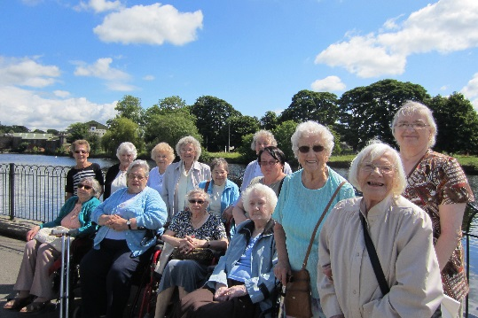
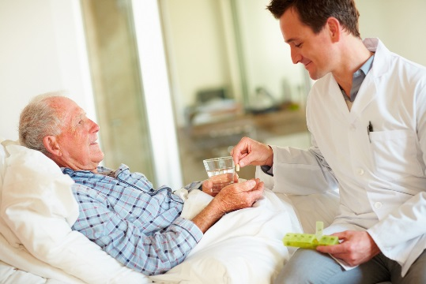
Risk assessments
As your employer, when we carry out risk assessments, we examine all the procedures and activities that take place in our organisation and assess the level of risk involved. In our care home, for example, this will range from risks associated with routine care procedures to organising social events and taking service users on outings / trips.

Slide 27
Risk assessments
The responsibility for completing a risk assessment is given to a senior member of staff, for example, your supervisor.
An example of this is Jo, who is our senior care assistant, who is responsible for assessing the risks associated with the bathing of any new residents.

Slide 28
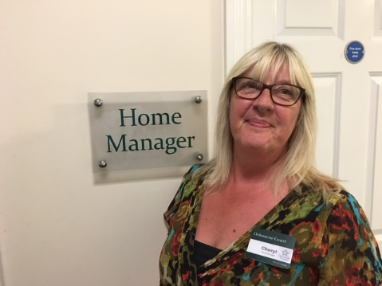
Risk assessments
Our care home manager, Cheryl, has the responsibility of ensuring that Jo has the correct training required to carry out this task.

Slide 29
Risk assessments
Step by step…
1. Identify the hazards at the setting, or in carrying out an activity.
2. Identify those at risk, including service users, staff, volunteers and other visitors.
Evaluate the level of risk – usually rated on a scale of 1 to 4, with 1 being the lowest level of risk.

Slide 30
Risk assessments
Step by step…
4. Identify ways to limit the risk – this will include specific actions to minimise risk.
5. Review measures taken to minimise the risk.
Task:
Complete the risk assessment activity in your workbooks
Notes:
Could use a timer to keep the class on pace – 15/20mins.

Slide 31
Safeguarding
If a child or a vulnerable adult shares information with you that raises concerns about their personal safety, or they disclose that they are being abused, you should follow the setting’s safeguarding policies.

Slide 32
Safeguarding
As an employee or volunteer, you must listen carefully to the service user and avoid asking questions. Let the service user tell you their story in their own way and in their own words. In this instance, you will have to explain to the service user that the information will need to be shared with somebody more senior.
What is the name of the role that is responsible for investigating the claim or accusation?
What will you be asked to provide?
Notes:
Q1: Safeguarding Officer
Q2: Written record of what you have been told.

Slide 33
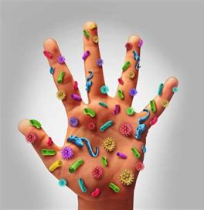
Protection from Infection
Working in a care environment requires all staff and volunteers to ensure that they maintain a clean and hygienic working environment and minimise the likelihood of passing on infection. In order to keep yourself and others safe from infection, you must ensure that you are familiar with the setting’s policies and procedures in place to minimise any risk.
Notes:
Q1: Safeguarding Officer
Q2: Written record of what you have been told.

Slide 34
Protection from Infection
Washing hands
Linen
Minimising the spread of infection
Sharp articles e.g. needles
Equipment
Notes:
This could be drawn up on the board and notes added to during class feedback.
Students should answer the think higher, which asks them to add their own main points onto the mind-map. Additional points can include:
Use of alcohol hand-rubs
Wearing protective gloves and aprons when you have contact with someone who has open wounds, or other fluids
Wearing protective clothing for any activity that involves close personal care contact with body fluids.

Slide 35
Control and disposal of substances harmful to health
https://youtu.be/7788C0p8NQQ
To protect all service users, staff and visitors from harm and infection, you must ensure that hazardous waste is disposed of properly.
Task: Answer the two questions in your workbook.
Notes:
Video = fun rap (30 seconds long), but introduces harmful substances. OPTIONAL

Slide 36
Control and disposal of substances harmful to health
The Control of Substances Hazardous to Health (COSHH) Regulations (2002) provide guidance for the safe disposal of hazardous waste.
In care settings, different coloured bags are often used to ensure the safe and efficient disposal of hazardous waste.
Task: See if you can match up the type of waste with the appropriate method of disposal.

Slide 37
Did you get them all?
Flushed down a sluice drain: area must then be cleaned and disinfected
Clinical waste, e.g. used bandages, plasters or other dressings
Needles and syringes
Blue bag: returned to the Central Sterilisation Services (CSSD) for sterilising and reuse
Body fluids, e.g. urine, vomit and blood
Yellow bag: waste is burned in controlled settings
Soiled linen
Red laundry bag: laundered at the appropriate temperature
Recyclable equipment and instruments
Yellow ‘sharps’ box which is sealed: waste is burned in controlled settings

Slide 38
Reporting and recording of accidents and incidents
There are particular illnesses, diseases and serious accidents that health and care providers must officially report. These are covered in the Reporting of Injuries, Diseases and Dangerous Occurrences Regulations (RIDDOR) (2013).
RIDDOR GAME!
What types of illnesses and incidents have to be reported?
Notes:
Answers on next slide.

Slide 39
To RIDDOR or not to RIDDOR?
Broken bones
Flu
Death
General Sickness
Second degree burn
Paper cut
Food poisoning
Stubbed toe
Tripping up
TB
Rubella
Diphtheria
Notes:
When in presenter mode, click on each of the grey rectangles and they will change colour depending on whether they are reportable or not.
Flu, paper cut, stubbed toe and general sickness are not listed as reportable incidents, illnesses or injuries.
Tripping up is amber, as this would depend on whether the tripping up happened as a result of a direct work related activity e.g. if there was something that the person tripped over such as a piece of equipment left unattended, or if there was damage to the flooring etc. This would not need to be reported if the person simply tripped over their own feet, for example.
If someone slips or trips at work, e.g. wet floor, then the incident must be reported even if there is no injury involved. This should be done in an accident book.
Questions could be asked of students e.g. do you think that everything that should get reported under RIDDOR does? What are the potential impacts of this on employer and employee?

Slide 40
Reporting and recording of accidents and incidents
Imagine that you need to record an accident that has happened.
Complete the form in your workbooks.
Notes:
Answers on next slide.

Slide 41
Eye on the exam…
Notes:
Students should recognise that the reason why this answer did not get full marks was because the points were not expanded.
Model answers from mark scheme are:
Risk assessments completed (1), where risks are identified and managed (1)
Accidents and near misses reported (1), action taken to reduce reoccurrence (1)
Reduces the incidence of accidents (1), reducing complaints / redress / compensation (1)

Slide 42
Complaints Procedures
Read through the information in your workbooks and complete the task and think higher activity.
Notes:
Task: Students should explain that they should report the complaint to their line manager or safeguarding officer. They should inform the service user that they will need to report this complaint.
TH: The service user may lose trust in the care provider. They may report this and the service provider may receive negative press. Students may come up with other answers.

Slide 43
Information management and communication
Health and care organisations hold a wide range of diverse information about service users.
Information
Notes:
TASK: Information held could include:
Preferred TV programmes
Holiday arrangements
Address
Telephone number
Family details
Information about criminal convictions
Health issues

Slide 44
GDPR
After watching the two videos below, write what the GDPR is in your own words.
https://youtu.be/6fITStJ-4Es
(03:25 - Top 5 things to consider for your GDPR preparation)
https://youtu.be/6IRE3CjqS0M
(3:01 - CNBC International – Why everyone is freaking out over four letters)
The GDPR is a piece of European legislation that sets out clear guidelines on the use, storing and processing of personal data of citizens within the European Union (EU).
The Data Protection Act (2018) is the UK’s implementation of this legislation. Both the GDPR and Data Protection Act came into force in the UK on 25 May 2018.
Notes:
TH: This legislation may affect H&SC in terms of how data is processed and handled by professionals and organisations. People may make mistakes or feel unconfident about this if they are not adequately trained.

Slide 45
GDPR
The legislation covers information stored electronically on computers, mobile phones and social media sites, along with paper-based personal information. It is against the law to have photographs of service users without their permission.
The rules do not apply to:
The processing of personal data of deceased people;
The processing of data by an individual for purely personal reasons or for activities carried out in your own home, providing that there is not a connection to a professional or business activity.

Slide 46
7 key principles
Not be kept for longer than is necessary
Be collected and used honestly and fairly
Be kept safe and secure
Be used only for the reasons for which it has been given
Data must…
Be limited to what is necessary for the purpose – no ‘spare’ data
Be maintained by a ‘controller’, who is responsible and accountable for complying with this legislation
Be accurate and up to date

Slide 47
Collection, storage and use of data – can you fill in the blanks?
need
never
electronically
locked
procedures
codes
senior
policies
responsibility
practice
protected
weaknesses
risk
right
identified
security
discloses
abuse
valid
safeguarding
Safeguarding officer
regulate
Notes:
Optional – you can put these words up on the board for students to try and complete the task with, or see if they can try and answer these in pencil first without the words shown, then pen over the words they are confident with. Time dependent.
You can say that words may be used more than once!
The answers are shown on the following slide.

Slide 48
Recording and storage of data
The Act covers the policies, procedures and systems for:
Storing information – confidential information should be stored in LOCKED filing cabinets in LOCKED rooms. Information held ELECTRONICALLY should be protected by a secure password.
Accessing information – members of staff who are allowed access to this information should be clearly IDENTIFIED. Staff should NEVER have access to personal information that they do not need to know. Where information is stored electronically, only the relevant staff should have personal access passwords.
Sharing information – information should only be shared with other professionals who have a NEED and a RIGHT to know it.
Notes:
Answers are shown on this slide, for teacher reference only. It is probably too small to display on screen, so would be best to talk through with students.

Slide 49
Legal and workplace requirements
The principles and requirements of the legislation and the requirement for confidentiality are within the POLICIES and PROCEDURES of all health and social care settings. They are also embedded in the CODES of PRACTICE of the professional bodies that REGULATE health and care staff, such as the General Medical Council (GMC), Nursing and Midwifery Council (NMC) and the Health and Care Professions Council (HCPC).
All employees and volunteers in organisations have a RESPONSIBILITY to ensure that the confidentiality of service users’ information is PROTECTED. They also have a duty to actively promote respect for confidentiality throughout the setting. If they spot WEAKNESSES in the procedures, they should feel confident to suggest improvements in the systems and arrangements. This is necessary to ensure the safety and SECURITY of service users and to respect their right to the confidentiality of personal information.
Notes:
Answers are shown on this slide, for teacher reference only. It is probably too small to display on screen, so would be best to talk through with students.

Slide 50
Confidentiality, safeguarding and legal disclosure
All personal records must be kept safely and securely and used only for the purpose that they are intended for. They must not be available to people who do not have a VALID professional need to know the details.
If a child or a vulnerable adult DISCLOSES to any member of staff or volunteer that they are at personal RISK or that they are the subject of ABUSE, the setting’s SAFEGUARDING policies should be followed.
In this situation, you will need to explain to the service user that their disclosure will be shared with a SENIOR member of staff who will support them. The SAFEGUARDING OFFICER at the setting will then take over responsibility for dealing with the concerns.
Notes:
Answers are shown on this slide, for teacher reference only. It is probably too small to display on screen, so would be best to talk through with students.

Slide 51
Accountability to professional organisations
The standards of professional practice expected of professionals working in health and care settings are regulated and monitored by a range of professional bodies including:
General Medical Council (GMC)
Nursing & Midwifery Council (NMC)
Health & Care Professionals Council (HCPC)

Slide 52
Accountability to professional organisations
Specific regulations vary according to your profession; however, each professional organisation monitors the:
Level and content of the initial training and education of members within their profession
Ongoing professional development, up-to-date training and further training
Standards of professional practice in everyday work
Standards of personal conduct, both at work and in leisure time.
What is this training known as?
Notes:
Training is known as CPD – Continuing Professional Development.
Students will then have to complete a task to try and match up the titles with the relevant description.
Answers on following slide!

Slide 53
Accountability to professional organisations
Revalidation procedures
Members are required to complete regular CPD in order to remain on the register. Requirements will always include evidence that members have current and up-to-date understanding of safeguarding regulations.
Codes of professional conduct
These are published for members and must be followed. If a member is accused of failing to meet standards set, this is investigated and, in extreme circumstances, the member can be removed from the professional register and barred from practice.
Care Certificate
This is not a legal requirement. It provides a set of standards that health and social care workers should follow in daily working life. This was introduced in 2015 for newly appointed health and social care workers who are not members of the regulated professional bodies (e.g. NMC).
Notes:
Answers!

Slide 54
Eye on the exam…
Answer the 4 mark question in your workbooks.
Move onto the next task. Read through the answer and see what mark you would give this answer if you were marking it.
Rewrite this answer to create a model response using the mark scheme.
Notes:
Eye on the exam – taken from January 2018 paper.
Students are to answer the 4 marker question. You can choose whether to peer assess, self assess or collect in.
Mark Scheme:
Award one mark for identification and one additional mark for appropriate expansion up to a maximum of four marks.
• Communicate only with the staff who need to know information about Melanie (1) by adhering to legal and workplace requirements specified by the codes of practice (1).
• Safe and secure storage and retrieval of medical and personal information (1) by applying the requirements of the Data Protection Act 1998 (1).
• Following appropriate procedures (1) by ensuring they use password protected security access (1).
Accept any other valid response.
SECOND TASK – EXAMINER’S REPORT – this response got 2 marks out of 6.

