Slide 1
Unit 2: Working in Health and Social Care
Starter:
On a mini whiteboard, list as many different health and care professionals you can think of.
Think higher – give one example of how each of the professionals will support service users.
Holy Cross College Hospital
NHS Foundation Trust
May 2018

Slide 2
Learning objectives…
By the end of this lesson, you will be able to:
Identify the different health care professionals.
Explain the role of each professional.
Identify the support each professional provides the service user.
Discuss the impact the professional can have on a service user.

Slide 3
Professionals in the Health Care Sector
Doctors
Nurses
Midwives
Healthcare assistants
Social workers
Occupational therapists
Youth Worker
Care Manager
Care Assistants
Support Workers

Slide 4
Doctors
There are a number of different types of doctors who specialise in different areas.
Can you think of five different types of doctor and what they specialise in?
Task:
Discuss with the person sitting next to you and write down your ideas in your workbook.

Slide 5
Doctors
General Practitioners (GP)
A GP is the primary point
of contact when a person is unwell. A GP provides ongoing Health Care for people in the community.
This includes
Caring for people who are unwell including simple surgical procedures
Preventative care and health education.

Slide 6
Doctors
General Practitioners (GP)
A GP has a number of responsibilities.
Task:
Discuss with the person sitting next to you what these responsibilities are and write them in your workbook.
Think higher: next to each responsibility write how this will help the service user.

Slide 7
Doctors
General Practitioners (GP)
Diagnose
Treatment Plan
Health Education
GP Responsibilities
Medication
Vaccinations
Treatments
Referrals
Monitor Treatments

Slide 8
Hospital Doctors
Three Levels
Junior Doctors
Registrars
Consultants
Geriatric -
the frail elderly
Psychiatry – mental ill health
Hospital Doctors
Paediatric – children
Cardiology – people with heart conditions
Oncology – people with cancer

Slide 9
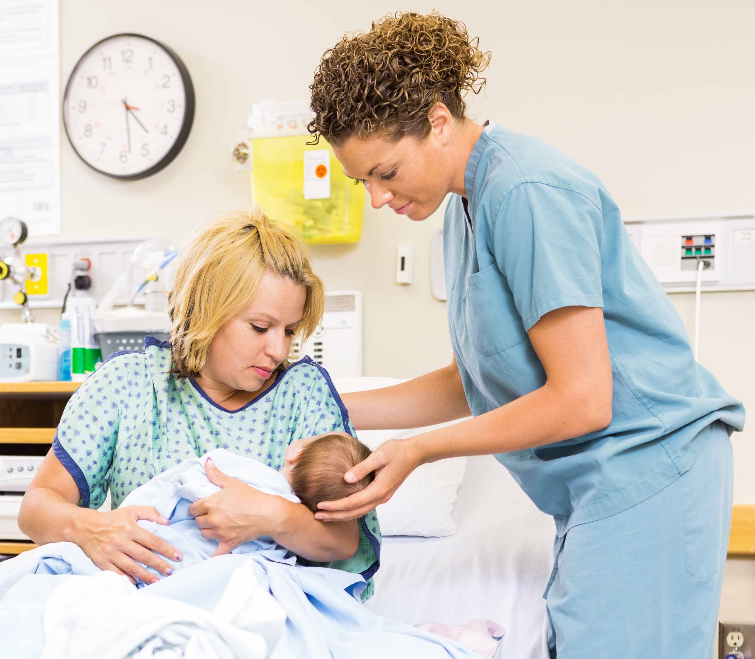
Midwives
Play a central role supporting women through all the stages of pregnancy providing antenatal and postnatal care.
What is meant by antenatal and postnatal care? What type of care would be included in antenatal and postnatal care?
Task:
Discuss with the person sitting next to you and write down your ideas in your workbook.

Slide 10
Nurses
There are a number of different types of nurses who specialise in different areas.
Can you think of five different types of nurses and what they specialise in?
Task:
Discuss with the person sitting next to you and write down your ideas in your workbook.

Slide 11
Nurses
Task: Research what each nurses role is and write your findings in your workbook.
Largest group of professionals in
health services.
School Nurses
Adult Nurses
Mental Health
Health Visitors
Paediatric Nurses
Nurses
Practice Nurses
District Nurses
Learning Disability Nurses
Neonatal Nurses

Slide 12
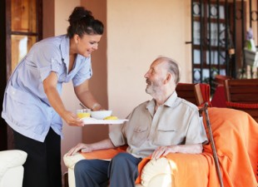
Healthcare Assistants
Often known as nursing assistant or auxiliary nurses. They work under the guidance of qualified healthcare professionals such as midwives and nurses.
They work in many healthcare settings including GP practices, hospitals and nursing homes.
Duties include:- Taking patients temperature and pulse, making beds, washing and dressing patients, serving and assisting with meals

Slide 13
Occupational Therapists
Work with people of all ages who struggle with practical routines of daily life.
This may be due to a disability, physical or psychological illness, an accident or old age.
Specific activities will be agreed with patient to help them overcome barriers to independent living.
Work in patients home, GP practices, nursing homes, prisons, social services and hospitals.

Slide 14
Social Workers
Help and support people of all ages through difficult times in their lives.
Ensure vulnerable people are safeguarded and help them to live independently. Including children, people with disabilities, mental health problems and the frail elderly.
Social workers specialise in either children or adult services. How would the services required for children and adults differ?
https://youtu.be/84bE1M6Usz0
Task: Discuss with the person sitting next to you and write down your ideas in your workbook.

Slide 15
Social Workers
Adult Services:- Older people, adults with disabilities, adults with mental health problems. Support them living independently and in residential care, work closely with families and carers. Child Services:- Provide support for children and their families. Ensure child is safe and protected from abuse. Implement special measures for children at risk. In extreme circumstances this may include removing the child their home. Manage fostering and adoption processes. Work in children's residential settings and support young people leaving residential care.
Think Higher: Apply how the work of a social worker can help a service user Physically, Intellectually, Emotionally and Socially.

Slide 16
Youth Worker
Work with people ages 11-25. Support young people reach their full potential.
Work in a range of settings and are employed by the council or religious organisations or voluntary organisations.
Research the type of settings that a youth worker would be involved with?
Task: Discuss with the person sitting next to you and write your research in your workbook.

Slide 17
Youth Worker
Typical Activities:-
Delivering programmes relating to young peoples concerns including smoking, drinking, drugs, relationships and dealing with violence.
Residential activities
Sports teams
Managing community projects
Supporting parents for child’s healthy development

Slide 18
Care Assistants
Provide practical help and support for people who have difficulties with daily activities.
Care assistants work in a wide range of settings including shelter accommodation, residential homes and day care centres.
What age groups do care assistants work with? What type of support do they provide?
Task: Discuss with the person sitting next to you and write your research in your workbook.

Slide 19
Care Managers
Key leadership role within residential care settings and are responsible for:-
Adults with learning difficulties
Older people in residential and care homes
People in supported housing
People receiving hospice care
Responsibilities include appointing and managing staff, managing budgets and ensuring the quality of care meets the required standards.

Slide 20
Support Workers
This role is closely linked to a
healthcare or nursing assistant discussed earlier.
Support workers work under the supervision of professional such as physiotherapists, occupational therapists and social workers.
Once a needed has been identified the support worker will work closely with the patient and their family to implement the plan.
They may provide support with parenting skills, financial management and domestic skills.

