Slide 1
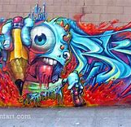
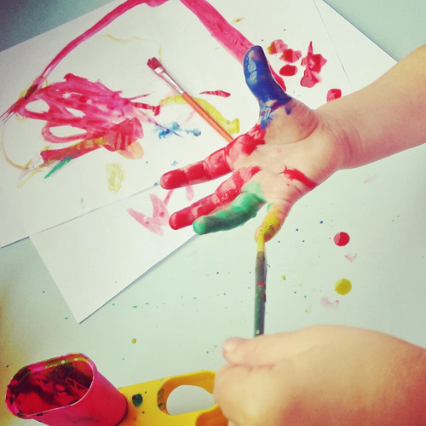
How is Art and design used to communicate

Slide 2
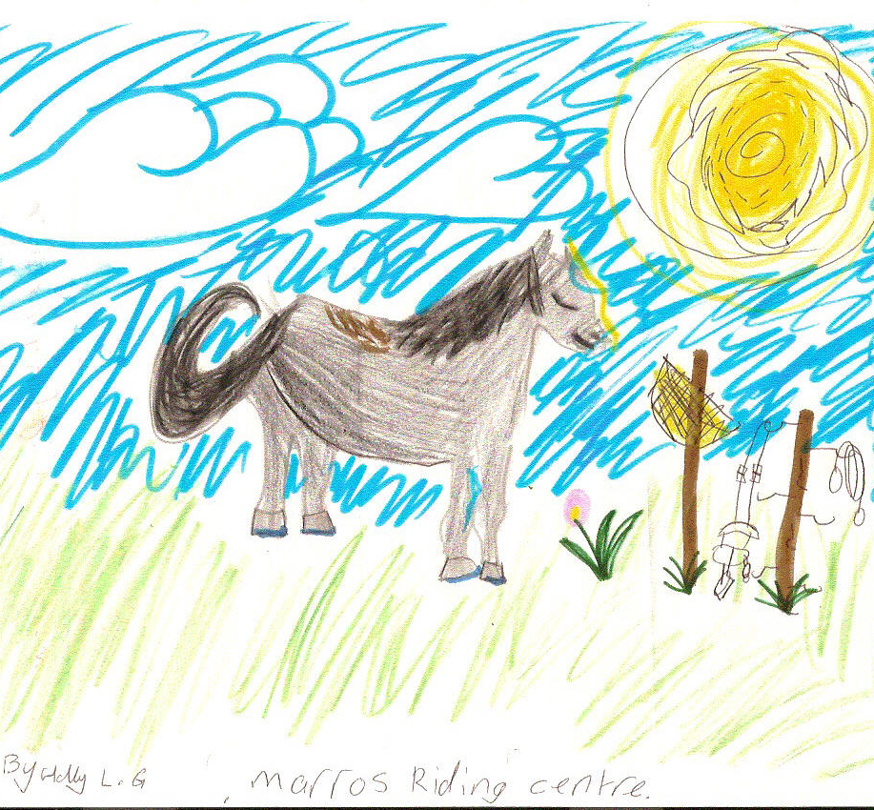
What is ART
SCULPTURES
DRAWRINGS
PICTURES
PAINTINGS

Slide 3
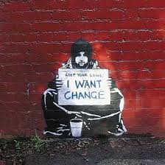
WHO CAN USE THIS FORM OF COMMUNICATION?
CHILDREN~ DON’T HAVE THE LANGUAGE SKILLS TO EXPRESS THEMSELVES
ELDERLY PEOPLE~ SOME ILLNESSS CAN TAKE AWAY FORMS OF COMMUNICATION
PEOPLE WITH IMPAREMENS~ DON’T HAVE THE PROPPER COMMUNICATION SKILLS TO COMMUNICATE
ARTISTS~ TO GET POWERFULL MESSGES ACROSS

Slide 4
How does this help?
Art can ~
Express ideas
Help calm/ show emotions through symbols or drawings
GET POWERFULL MESSAGES ACROSS

