Slide 1
Environmental factors THAT affect development
Unit B3

Slide 2
Discuss…
What do we mean by
environmental factors?
Give some examples.
What problems could be
encountered by environmental
factors? Hint: think health
issues.

Slide 3
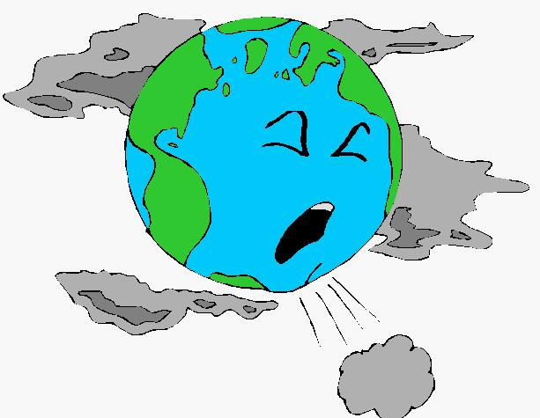
EXPOSURE TO POLLUTION
Air and water pollution can influence development and be a major source of ill health.
There is growing concern about the impact of air pollution both indoors and outdoors.
These concerns include the contribution it makes to particular illnesses such as asthma.
What would cause air pollution outdoors?
What would cause air pollution indoors?

Slide 4
Air pollution videos
What is air pollution?
How air pollution can affect your life

Slide 5
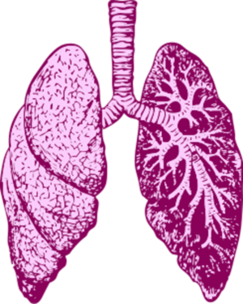
Respiratory disorders
Conditions affecting the upper respiratory tract, trachea, bronchi, bronchioles, alveoli, pleura and pleural cavity.
Tobacco smoke
Combustion products e.g. carbon dioxide, carbon monoxide
Toxic substances affect the nerves and muscles used for breathing, and the lining of the air passages.

Slide 6
Examples of respiratory disorders
Mild
Severe
Runny nose
Sore throat
Common cold
Bacterial pneumonia
Lung cancer
Asthma
Emphysema
Bronchitis

Slide 7
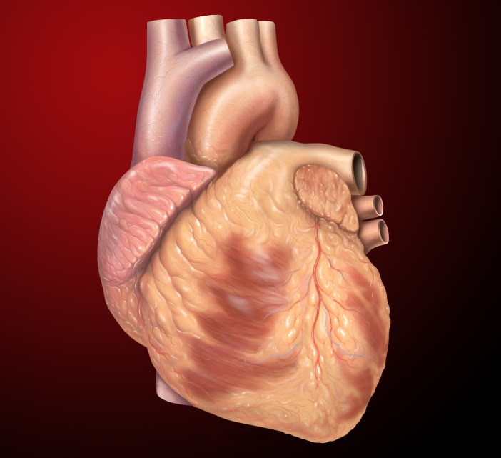
Cardiovascular problems
Any disorder or disease of the heart or blood vessels
Risk factors include smoking and air pollution.
Recent studies suggest that environmental pollution is linked to increased illness and death.

Slide 8
Examples of cardiovascular problems
Thrombosis
Pollution during pregnancy
Tobacco smoke is linked to changes in the lining of the heart and blood vessels causing blood clots.
This can lead to a heart attack.
The baby could develop congenital heart defects and cardiovascular disease in later life.

Slide 9
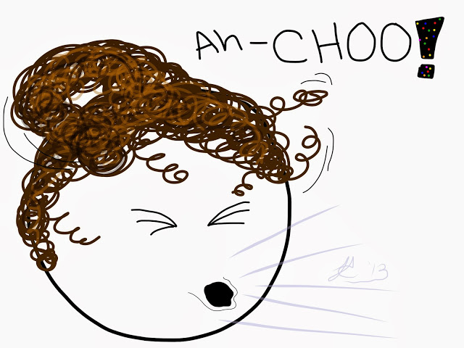
allergies
Caused by irritants such as dust or pollen causing the immune system to overreact
Usually chronic (persisting for a long time) as they are a response to the environment in which the individual lives.

Slide 10
Examples of allergies
Hay fever
Asthma
A seasonal reaction to pollen.
Symptoms include sneezing, watery and itchy eyes, a runny, itchy nose, lethargy and flu-like symptoms.
Can range from mild to severe.
An asthma attack causes difficulty breathing as the airways become inflamed and constricted. This is relieved by the use of an inhaler.
Asthma UK has reported than an average of 3 people per day die from asthma.

Slide 11
Statistics surrounding environmental pollution
Power stations are burning less coal, contributing to a fall in sulphur dioxide pollution.
Improved vehicle technology, such as catalytic converters, has also reduced air pollution.
Evidence from Social Trends Survey (2009) reported that emissions of nitrogen oxides fell by 46% between 1990 and 2006.
Although there have been improvements, official statistics still report concerns that air pollution is a serious problem.
Kings College London (2015) reported that nearly 9500 people die prematurely in London each year as a result of long-term exposure to air pollution.
London, Birmingham and Leeds are the most polluted cities in the UK.

Slide 12
In the news
What has been reported in the news this week about pollution and motor vehicles?
London “T-charge” – older vehicles have to pay £10 per day to drive in central London.
This came into effect on Monday 23rd October.
This is on top of a congestion charge of £11.50.
Diesel cars are now said to be much worse for the environment than originally thought.
What impact do you think this will have?

Slide 13
Poor housing conditions
How many health problems can you think of that would be associated with living in these types of conditions?

Slide 14
Problems with poor housing conditions
Overcrowded housing may limit access to washing, cooking and cleaning facilities.
Indoor air pollution, drying clothes indoors and inadequate ventilation.
Unsanitary – infections can spread quickly.
Lack of access to outdoor space – less exercise and fresh air.
Deprived areas are more likely to have problems with vandalism, substance misuse and other crime.

Slide 15
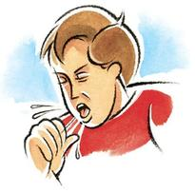
Respiratory disorders
Lack of heating and poor ventilation can cause damp and mould, leading to respiratory problems, especially asthma and allergic responses.
Babies, young children and the elderly are particularly vulnerable.
More than a million children in England live in overcrowded housing and are at risk of meningitis and respiratory problems.

Slide 16
Cardiovascular problems
Children living in overcrowded housing for extended periods of time tend to have problems with their growth rate and an increased risk of heart disease.
Poor quality housing can lead to stress, affecting blood pressure. High blood pressure can lead to blood clots and strokes.
Lack of exercise and a poor diet can also contribute to cardiovascular problems.
Unhealthy lifestyles, including smoking, drinking and a poor diet – ready-made meals are high in sugar, salt and unsaturated fats.

Slide 17
hypothermia
Excessively low body temperature, below 35˚C.
Fuel poverty – families with low incomes are unable to afford to heat their homes, especially in older properties.
Age UK (2012) found a link between loneliness and the risk of hypothermia in elderly people living in poor housing.
Many people over 65 spend more time at home and poor heating and insulation have been linked to a rise in winter deaths.

Slide 18
Anxiety & depression
Poor quality housing is linked to stress, anxiety, depression and mental health issues.
Why might poor living standards lead to mental health issues? What examples of poor living standards can you think of?
Fear of homelessness
Noisy environment
Isolation
Decreased educational attainment
Disrupted sleep patterns
Lack of personal space and privacy
Fear of crime
Excess cold – slower physical and cognitive growth in children

Slide 19
Access to health & social care services that affect development
According to National Institute for Health and Care Excellence, local authorities need to improve services for people who do not usually use health & social care services.
Each local public health authority has to ensure multi-agency and partnership working within these services to meet the needs of people who live in the local community.
Services should be inclusive and have a positive impact on local people and communities.
The local authority has a responsibility to identify barriers to accessing services.
What could these barriers include?
Transport
Opening hours
Cultural

Slide 20
Barriers to accessing services
Availability of transport
Opening hours of services
Travelling to appointments can be stressful – if households don’t have access to a car, they have to rely on public transport.
Unreliable transport can result in missed appointments, which can have a negative impact on vulnerable people or families with young children.
Financial impact – on health and social care services, and for people attending regular hospital appointments.
Some groups of people may not have the same access to services as others.
Hospital and GP appointments during working hours do not reflect the busy lifestyles of some service users.
However, some services have been introduced to improve access – NHS Walk-In Centres, the NHS 111 service and NHS Direct.

Slide 21
Think-Pair-Share
Identify the particular problems of accessing health and social care services that a person with a learning disability might face.
Give examples of other groups or individuals who may have difficulty in accessing services.

Slide 22
People who do not access services
Homeless people and vulnerable immigrants, why may be at risk of infectious diseases, such as tuberculosis.
Some families are difficult to reach, e.g. travelling communities and families whose first language is not English.
It is important to ensure that children in these families are fully immunised against childhood infections such as meningitis C and measles.
Many people may also not be registered with a GP, or find it difficult to get to a surgery or clinic (long working hours, caring responsibilities, transport difficulties).

Slide 23
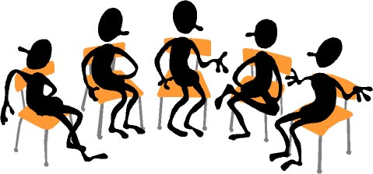
In small groups…
Discuss:
Why might people require health & social care in their own home?
What kind of support is available?
Who might deliver it?
Be prepared to share your ideas with the class.

