Slide 1
Relevant skills
The specific knowledge and skills required for working in the health and care sector varies according to the wide range of specialist job roles
Health and care is a rapidly changing sector in which changes in the size and structure of the population present new challenges, legal requirements change and new treatments and procedures are introduced at a fast pace.
In December 2012, the Chief Nursing Officer for England launched a three-year strategy for all nurses and midwives entitled ‘Compassion in Practice’.
Central to her campaign was the focus on six key values, which came to be known as the Chief Nursing Officer’s 6Cs

Slide 2
What were the 6 Cs?

Slide 4
How policies and procedures affect people in these areas
The policies, procedures, codes of practice and codes of conduct for the caring professions have become more specific in recent years.
They are presented so that professionals, service users and their carers can understand them clearly, and they are more rigorously enforced.
The inspection agencies have a specific responsibility to monitor standards of provision, and to require immediate action where significant failings are identified.
Since the publication of Robert Francis’s report in 2013 into the failings of the Mid Staffordshire NHS Trust, issues of patient safety and the quality of care have been even more in the public eye

Slide 5
Mid Staffordshire NHS Trust- Poor quality of care
Concerns raised in 2007 about an apparently high death rate.
Serious failings in the quality of care provided:
Chronic staff shortages
Patients had inadequate access to food and water
Patients left in soiled bedding
A culture where raising concerns about the quality of care was discouraged
A failure in the management and leadership of the trust.

Slide 6
Mid Staffordshire NHS Trust- Outcomes
As a result a further report was set up to investigate the quality of recruitment, training and support for non-registered staff in hospitals and other care settings (incl. doctors, nurses and other professionals).
Employers are required to ensure all newly appointed support staff complete the Care Certificate which covers 15 units of study:
Understanding the role as a support worker
A carer’s duty of care
Equality & Diversity
Communication
Privacy & Dignity
Safeguarding
Health & Safety
Infection prevention and control.
The Care Quality Commission (CQC) are responsible for ensuring that the Care Certificate is effectively delivered and should be completed within 12 weeks of a new entrant beginning their job.
Think about your H&SC units- they link to each of these!

Slide 7
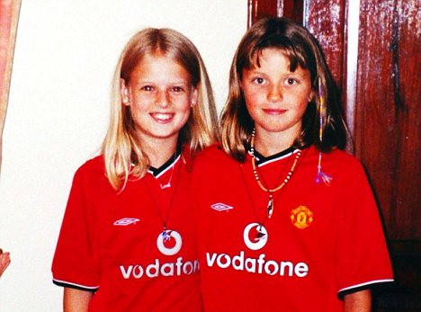
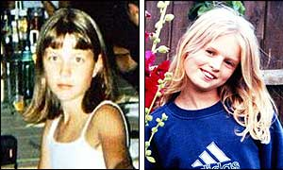
In August 2002, two primary school children, Jessica Chapman and Holly Wells, were reported missing from their home.
2 weeks later their bodies were found. They had been sexually abused and murdered.

Slide 8
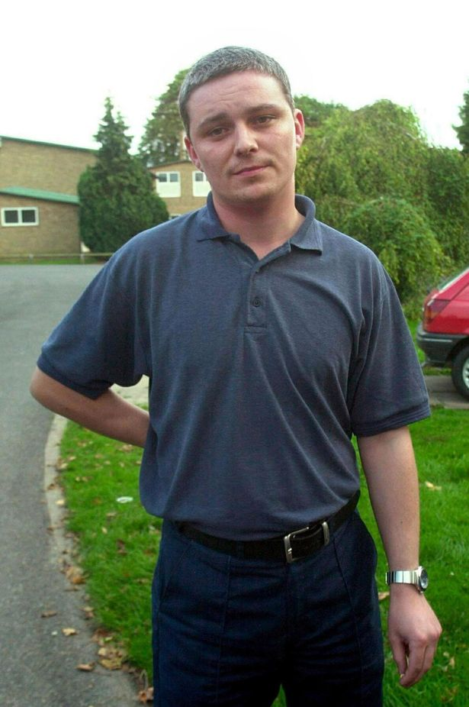
Their schools caretaker was found guilty of their murders.
It emerged during the investigation that the caretaker had been investigated in the past for sexual offences and burglary, but he had still being appointed to work in a school.
An enquiry was set up to investigate the tragedy. One of the key recommendations of the Bichard Report was that there should be a statutory agency with responsibility for vetting all individuals wanting to work with children or vulnerable adults, whether as a paid member of staff or as a volunteer.

Slide 9
Notes:
Hyperlinked image: https://www.youtube.com/watch?v=HEnGG39gtuY
Not essential to watch but may be suitable for less able groups to give more background information to Ian Huntley.

Slide 10
Exposure of serious failings within the vetting system
Though Ian Huntley had no convictions for sex offences, he had been reported to police in his native Humberside on six occasions over sexual assaults or sexual relationships with underage girls.
In addition social services in the north east investigated four relationships between Huntley and schoolgirls, one only 13, and an alleged indecent assault on an 11-year-old girl.
But checks made by police on Huntley when he was appointed caretaker of Soham Village College failed to unearth these details of his past.

Slide 11
Exposure of serious failings within the vetting system
Huntley slipped through the net as the Criminal Records Bureau relied on local police forces to provide it with intelligence material - details which do not lead to a conviction.
Under the vetting system in place at the time he also had to disclose his date of birth, any previous names and home addresses for the previous five years.
Cambridgeshire county council said these details, including the name Ian Huntley, were passed on to the police. As was normal, Huntley began work before the check came back.
Cambridgeshire police's criminal records bureau checked the would-be caretaker on the police national computer (PNC) under the name Nixon.
The civilian operator failed to check him under the name Huntley. Police admit this was an error and disciplinary proceedings against the operator could follow.

Slide 12
The 2004 Bichard Inquiry looked at the existing processes for vetting.
While a fledging Criminal Records Bureau had been set up in 2002, Bichard recommended that a national registration scheme be set up, through which convictions and police intelligence could be shared.
Ten years later, we now have the Disclosure and Barring Service.
In 2011, there were 4.1million applications, of which 20,000 were found to be unsuitable to work with children and vulnerable people.

Slide 13
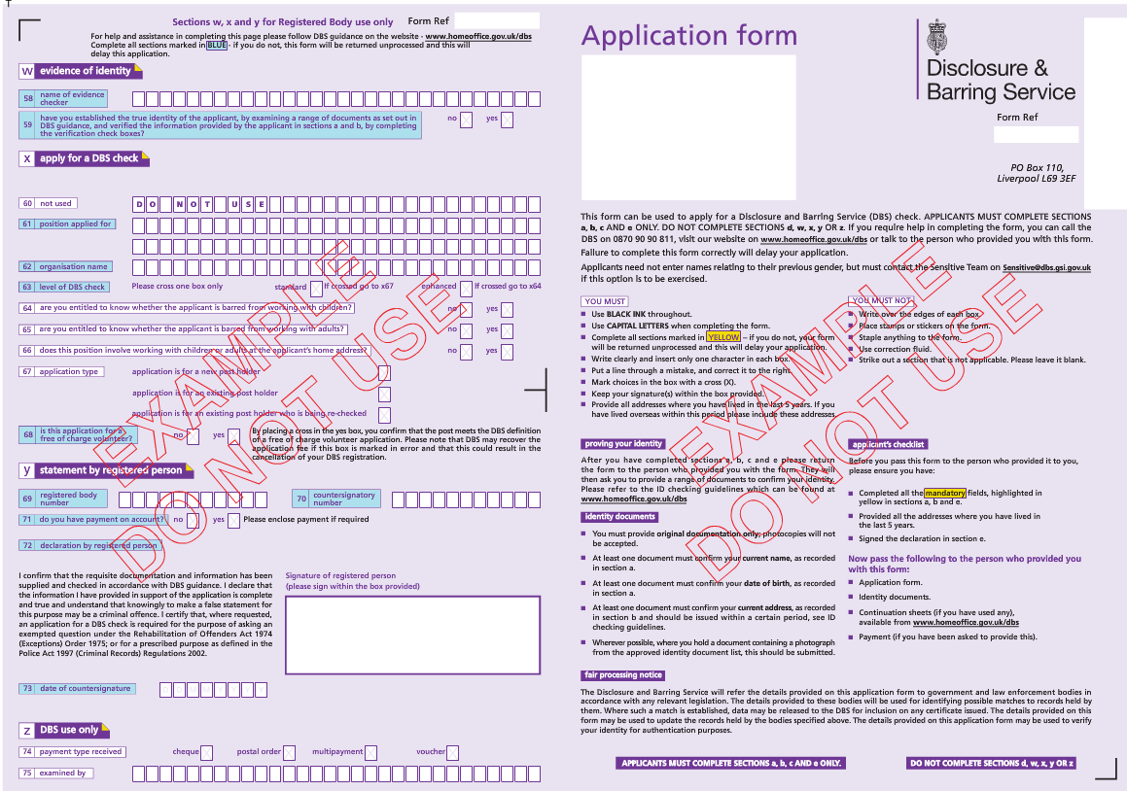

Slide 14
The aim of this information and why it’s required is to ensure that you are of good character for such a public facing job and allows the Public Carriage Office (PCO) to make an informed decision taking into account searches of police records, etc.
You will be required to apply for an enhanced check and this looks at :
nature of the offence(s)
circumstances in which any offence was committed
subsequent periods of good behaviour
overall conviction history
sentence imposed by the court
any other character check considered reasonable (e.g. personal references)

Slide 15
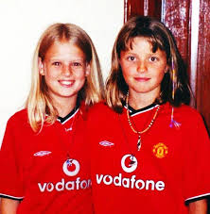
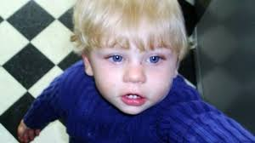
Changes in policy
Changes in policy and the regulation of care services have often been introduced following the investigations of failings in the health and care settings.
The following are examples of where this has been the case.
Baby P
Victoria Climbie
Jessica Chapman and Holly Wells

Slide 16
How regulation affects people working in these areas.
All staff working in care settings are affected by regulation and inspection, both of their provision and their professional practice.
Where provision is failing to meet the standards required, immediate action can be required and its implementation carefully monitored.
Where care professionals fail to meet the standards set by their regulators, they can be disciplined and in the most serious cases removed from their professional register.
This means they can no longer practice either voluntarily or in paid employment.

Slide 17
Protecting service users
Regulation requires staff to follow codes of practice, guidelines, policies and procedures which are designed to ensure that service users are protected and safe
Effective implementation of these documents ensures that staff:
Work together to prevent, and protect service users from abuse
Empower and support people to make their own choices
Provide services to people who are experiencing abuse, neglect and exploitation
Investigate actual or suspected abuse and neglect

Slide 18
Protecting staff
Policies and procedures protect managers, professionals, volunteers and staff working in public, voluntary and private sectors.
When health and social care workers follow policies and procedures they are:
Working within the law
Working effectively with colleagues
Implementing best practice to meet needs
Adhering to guidelines that are designed to keep them safe at work
Using the relevant skills required to work in their area
Minimising risk
More protected if something goes wrong

Slide 19
Policies and procedures
A
B
C
D

Slide 20
A
B
C
D

Slide 21
A
B
C
D

Slide 22
A
B
C
D

Slide 23
A
B
C
D

Slide 24
A
B
C
D

Slide 25
Do you think the statement below would impair a health and social care professional’s fitness to practice?
Describe one way that regulation ensures that people with specific needs who use health and social care services are protected and safe.
Yes
Consistently failed to meet practice standards
No

Slide 26
Do you think the statement below would impair a health and social care professional’s fitness to practice?
Describe one way that regulation ensures that people with specific needs who use health and social care services are protected and safe.
Yes
Neglected to inform the relatives of the well being of their service user at service users’ request
No

Slide 27
Do you think the statement below would impair a health and social care professional’s fitness to practice?
Describe one way that regulation ensures that people with specific needs who use health and social care services are protected and safe.
Yes
Committed fraud and abused someone’s trust with a dishonest act
No

Slide 28
Do you think the statement below would impair a health and social care professional’s fitness to practice?
Describe one way that regulation ensures that people with specific needs who use health and social care services are protected and safe.
Yes
Is having an improper relationship with service user
No

