Slide 1
Topic C – Effects of Ageing
C1: The physical changes of ageing
C2: The psychological changes of ageing
C3: The societal effects of an ageing population

Slide 2
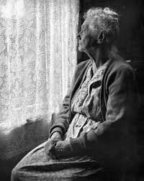
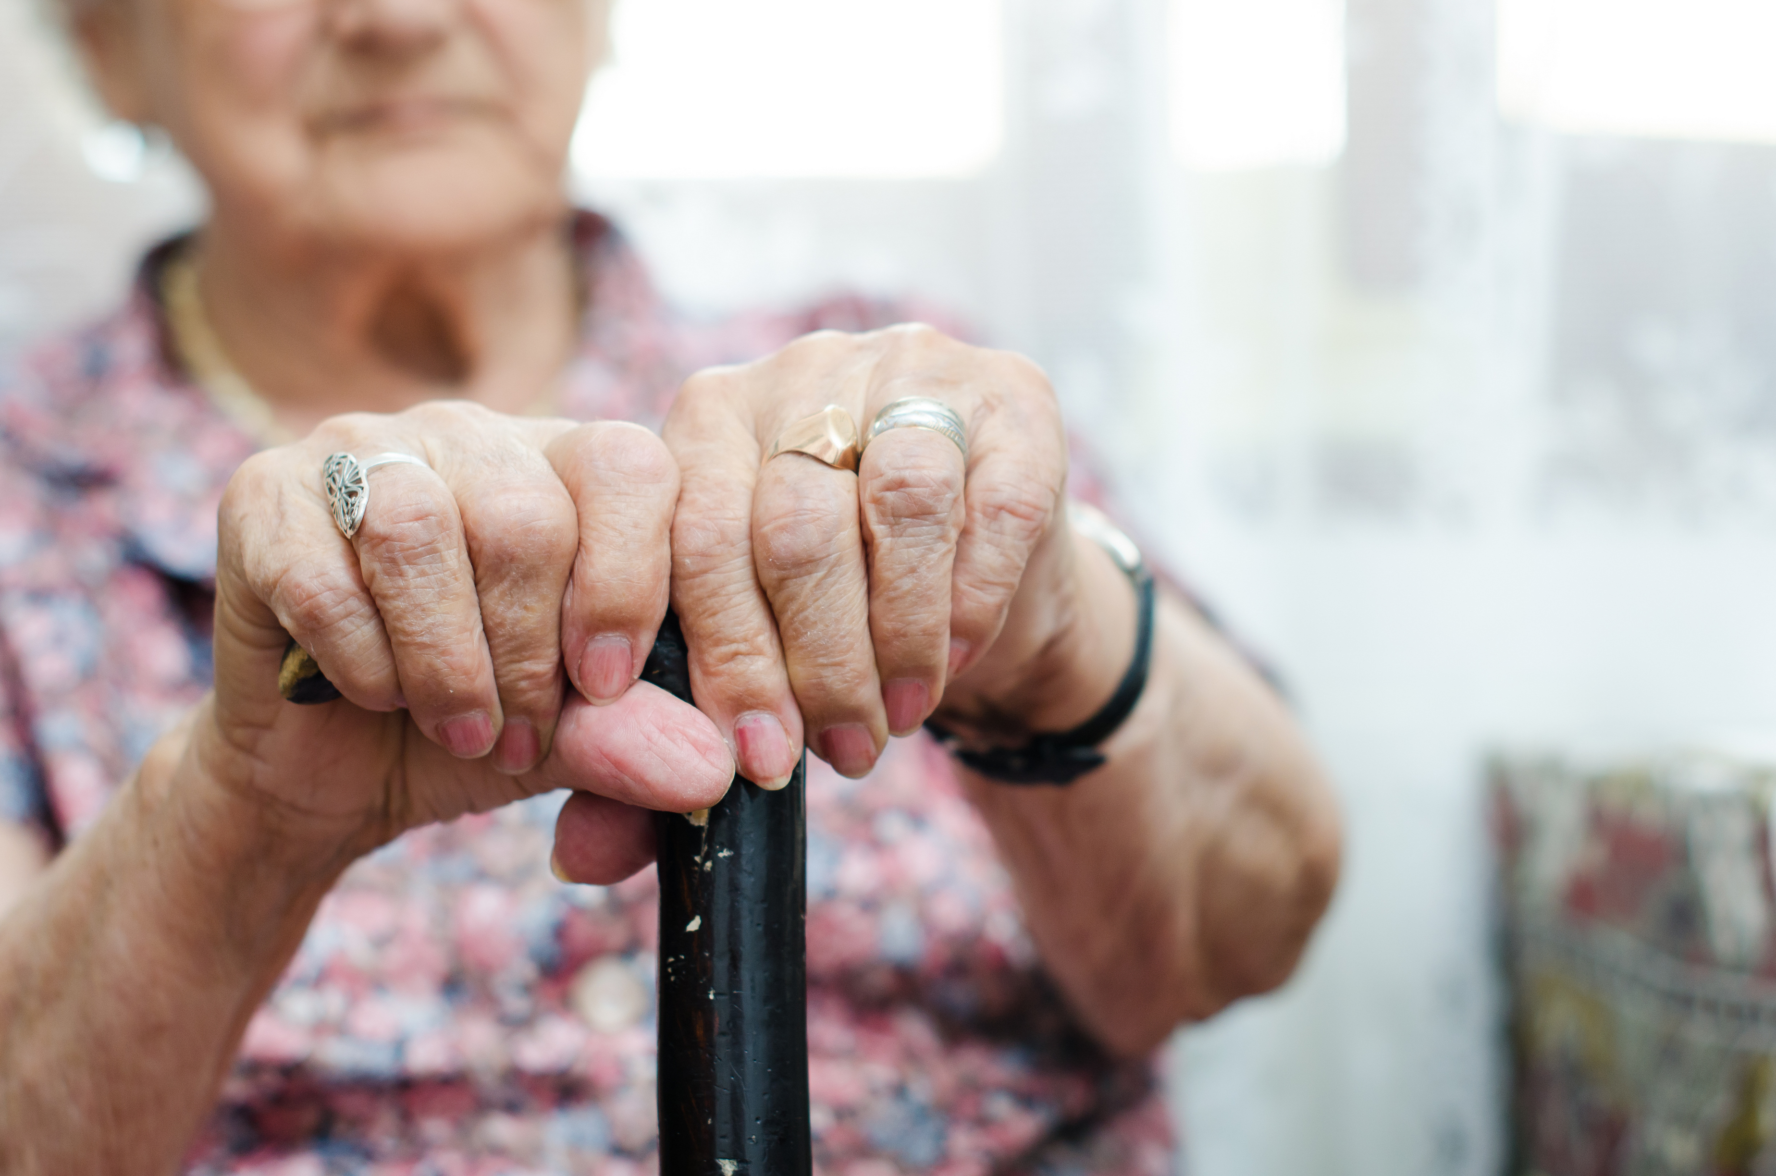
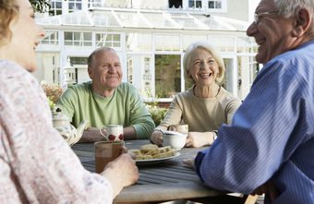
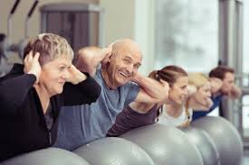
Topic C – Effects of Ageing
The psychological changes of ageing
The majority of people over state retirement age experience reasonable health, a satisfactory social life and a reasonable standard of living.
Why may the social life of an elderly person decline?
Poor health
Poverty
Isolation
Why may the social life of an elderly person improve?
More time
Less commitments to work
Uptake in new hobbies

Slide 3
Topic C – Effects of Ageing
Social Changes
Mind-map all of the possible social changes an elderly person may experience in later adulthood
Loss of friends
Stress of paying bills
Safety and security
Financial changes
Death of a partner
Decisions made on their behalf
Retirement
Turn to religion
Social changes
Grandchildren
Uptake in more physical activity
Isolation
Reliance on pension
New hobbies

Slide 4
Topic C – Effects of Ageing
Activity – Independent Task
Consider the psychological changes in the following examples:-
A gentleman in his 80’s who has lost his wife 6 months ago and suffers from prostrate cancer, he is also awaiting a hip replacement and cannot get out and about without the use of a wheelchair.
A lady in her 90’s who has been widowed for the last 15 years. She has poor hearing and suffers from osteoporosis. She lives in assisted housing. She has a daughter who lives near by but she has a very busy life.
Identify the following:
Effects on confidence and self esteem
Effects of social change
Financial concerns
Effects of culture, religion and beliefs.

Slide 5
Topic C – Effects of Ageing
Social Disengagement theory
Disengagement means to withdraw from involvement
Cumming and Henry proposed that older people:
Naturally withdraw from social involvement as they get older.
Experience reduced social contact
Become increasingly ‘individual’ and less concerned with others’ expectations.
For the following factors, consider the reason why they limit social interaction
Ill health
Geographical mobility
Retirement
Ill health of friends and relatives
Problem | Explanation
Ill health | Poor mobility or problems with hearing or vision may make interaction with other people more difficult.
Geographical mobility | Moving to areas away from friends and relatives in retirement. Family members may move away from older people in order to seek better housing or employment
Retirement | Retiring from work may mean less contact with people.
Ill health of friends and relatives | Friends or relatives may visit or contact less frequently if they have poor mobility or other disabilities.

Slide 6
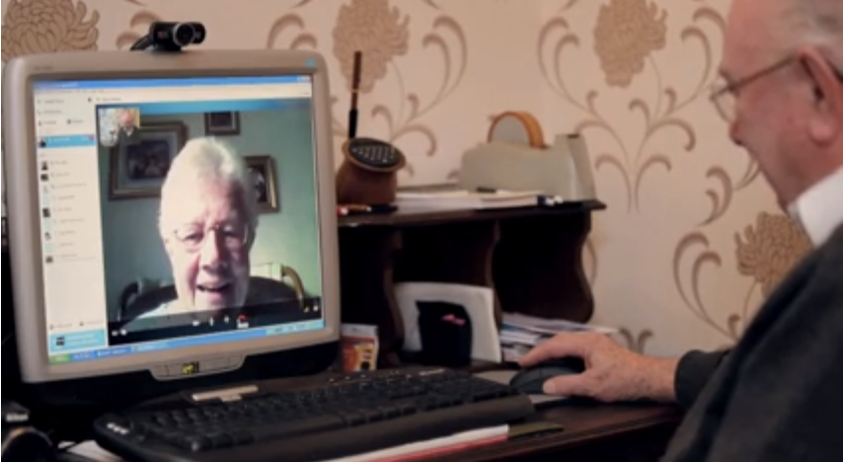
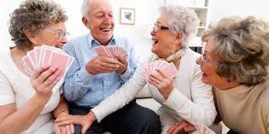
Topic C – Effects of Ageing
Social Disengagement theory - Arguments
Many elderly people remain socially active and involved with family and friends.
Give examples of how elderly may remain socially active:
Spending more time with children and their grandchildren
Joining new social groups and clubs
Remaining mentally active with hobbies
Internet communications
Phone calls

Slide 7
Topic C – Effects of Ageing
Active Theory
Activity theory was proposed as an explanation to ageing by Robert Havighurst in the 1960s.
Independent task:
Give reasons for why elderly may look forward to retirement
Explain why telling stories of past times (reminiscing) can help increase self-esteem and confidence
His theory recognises that:
Social and psychological needs of older people remain the same
Elderly adjust to their changes in health and mobility
Elderly take on new roles such as charity work, joining social groups or learning new skills

Slide 8
Topic C – Effects of Ageing
Check your understanding

