Slide 1
BTEC Health and Social Care Level 3
Unit 1
Developing Effective Communication in Health and Social Care

Slide 2
Unit 1 Developing Effective Communication
Broken down into 4 sections:
LO1 Understand effective communication and interpersonal interaction in health & social care
LO2 Understand factors that influence communication and interpersonal interaction in health & social care environment
LO3 Understand ways to overcome barriers in a health & social care environment
LO4 Be able to communicate and interact effectively in a health & social care environment

Slide 3
Unit 1 BTEC Level 3 Learning Objective 1
Contexts
Interpersonal interaction
Effective communication and interpersonal interaction in health & social care
One to one
Groups (formal & informal)
Communication with professionals
Multi agency working
Multi professional working
Types of. (speech, language, non-verbal)
Communication & Language
Communication
Forms of (text, written, oral, signing, symbols, touch, music & drama
Objects of reference
Arts & crafts
Technology )
Preferred method of communication (BSL, Braille, Makaton, signs or symbols and writing. Variation between cultures)

Slide 4
ACTIVITY
In groups discuss for 5 minutes a way of presenting at least 1 piece of information about everyone in your group to the rest of the class…
There’s only one catch…
You cannot communicate it
through speaking
No Talking
No Talking

Slide 5
Use of a Glossary
Key feature of all of the vocational subjects is that they have words that are unique or have a unique meaning.
We will all keep a Glossary
INTERPERSONAL
“Interpersonal skills are the techniques people use in order to communicate and maintain effective relationships”

Slide 6

ALWAYS REMEMBER PLEASE….
Every example you give in your work MUST be related to a HEALTH AND SOCIAL CARE SETTING.
Communication is important in all careers but we are specifically interested in health and social care environments!
You have 2 to write down as many HEALTH AND SOCIAL CARE SETTINGS as you can ☺

Slide 7
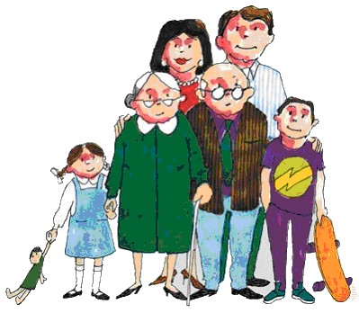
Youth club
Health and Social Care Services….
Care homes
Children's centres
Social workers
Physiotherapy
Dentists
Hospitals- doctors/ nurses
Schools and teachers
Counsellors
Counselling
Residential Homes
Nurseries

Slide 8

ACTIVITY
In groups of three choose 4 of the health and social care services and answer the following questions.
Why is communication important within that environment?
Who are we likely to be communicating with if we worked in that environment
EXTENSION
Give 3 examples of what EFFECTIVE communication actually is?

Slide 9
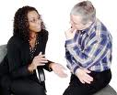
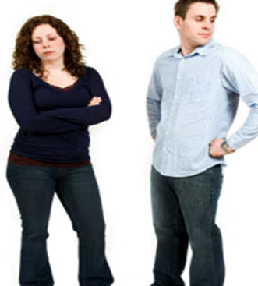
There are TWO main types of communication styles that we need to consider….
VERBAL COMMUNICATION
NON-VERBAL COMMUNICATION

Slide 10
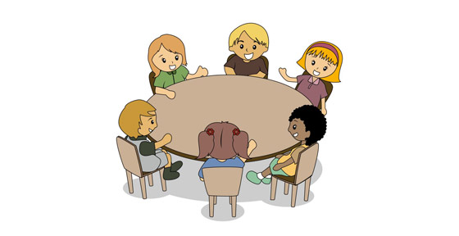
ACTIVITY
Think about your own communication experiences…
In groups share your experiences of verbal communication.
Think of both positive and negative experiences and brainstorm these on your paper.
Then come to a UNANIMOUS DECISION about what effective VERBAL communication means to your group ☺

Slide 11

So what is effective verbal communication?
Speaking clearly
Knowing your audience
Using appropriate language
Understanding the message you are trying to convey
Speaking at the correct pace

Slide 12
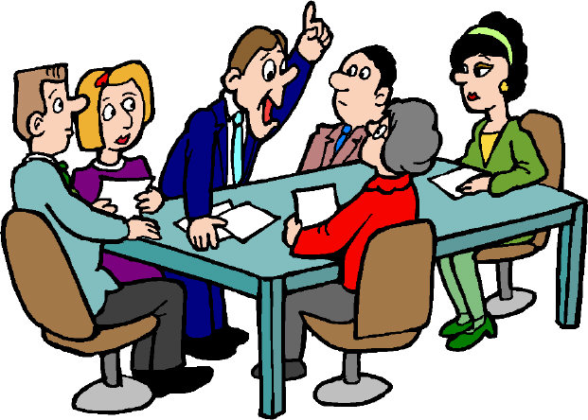
DISCUSSION POINT
Is non verbal communication as important as verbal communication?
5 minutes to discuss within your groups before we share with the class ☺

Slide 13

What have we achieved today?
Can we ALL identify key aspects of our first unit on effective communication?
Can ALL of us define what the two main types of communication are
Can MOST of us describe at least three steps to effective verbal communication
Has SOME of us started investigating the importance of non-verbal communication?

Slide 14
LO 1 Effective communication and interpersonal interaction in HSC
Your mum/dad | Teacher
Friend | Extended family member (cousin, aunty)
Sibling | Professional person (Doctor, Police, Soldier)
Contexts.
One to one communications
Activity
In pairs discuss how you greet all these people and then share with the rest of the group.
Why are the greetings with some of the individuals different?
Answer the way we individually interact with another person depends on the situation and (Context) you are in at that time.

Slide 15
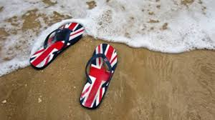
Context
Activity in pairs :
One person is interviewing the other for a job
But the person being interviewed cannot understand your accent (any regional one will do)
The person being interviewed really wants the job (how do they cope)
Reflection:
How did it feel? What were your emotions? Did you get frustrated?
How many of you have ben on holiday and seen British people trying to get their point across by talking really slowly and raising their voice?

Slide 16
Context
One-to-one (formal)
What differences do you think occur in a more formal one-to-one setting ?
Three stage model:
Warm up
Exchange
Wind down

Slide 17
This activity is designed to help you identify the different ways in which we communicate.
Activity: Get into pairs. For each of the scenarios below you need to point out what ways the people would communicate to each other. Think of things like the use of slang or not, is it formal, what we wear, how we say things and what environment they would be in
1) John is having a meeting with three members of management.
2) Gemma is hanging out with her friend
3) Ash is at work at a nursing home.
4) Karen and her friends are doing a summer job painting houses.

Slide 18
Context
Group communication Activity
In a large group you will discuss “What college is like in 6th form compared to Year 11”.
Whilst you conduct this group discussion TWO people will monitor the others:
Number of contributions to the discussion.
Eye contact towards others 1 whilst speaking themselves
2 when listening to others speaking
Taking turns - is this well executed or clumsy?
Looking at others reactions.
Does the group have a good atmosphere?
FINDINGS
Is there a group leader?
Is everyone good at taking turns?
Can everybody see each other clearly in the group?
How does it feel to be part of the group?
Honestly did you think of what to say before you said it (conversation in your head)?

Slide 19
Activity Group discussion Communication score
Use the table below to score yourself on a scale of 1 to 10 for each items below. 1-10, 1 being appropriate, 10 being not at all appropriate.
Now use the second sheet to score the other person on the same items, again 1-10.
Swop over and compare what you scored yourself and what they scored you as

Slide 20
Types of communication in HSC
Activity: In groups with a large piece of paper and pens. Your task is to identify as many types of communication that you can think of. Write your suggestions paper, we will discuss in class.
Types of communication | Description | Example

Slide 21
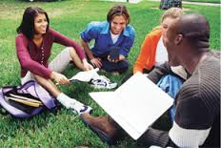
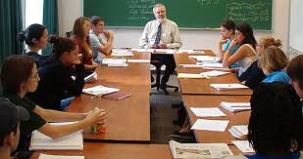
Context
Informal communication
Group discussion on the 6th form/college was an informal discussion. With each person having an equal part in the discussion/communication. Therefore the definition of this is informal.
Formal communication
The group discussion on the 6th form/college could have the same content but would be structured around an agenda follow a set purpose and suggested outcome for the meeting. Often not everyone who takes part in formal communications will have an equal part in the discussion, due in part to status, the formality and the agenda set for the group communication.

Slide 22
Context
Communication between professionals and people using the services
Health and Social Care has its (own) unique language. Terms and acronyms are used to explain parts of the body or procedures
Can you think of any examples or have you had experience of this yourself?
Everywhere we go we are surrounded by a massive variety of different languages. Instantly we think of people from different countries, English, Polish, German, but what about people from different areas of one country?
Also there is a language difference between a person of 80 and person of 16. This is called accent and dialect.
https://www.youtube.com/watch?v=wZO1daK1PN0
Accents: https://www.youtube.com/watch?v=FyyT2jmVPAk

Slide 23
Context
Activity: Read the example of language differences below and use the box below it to describe what these are two very different languages? Make NOTES!
Service User: “I ‘ave to look after me mum like an’ she’s playing up, an’ I can’t do it with more help like.
Professional: “You would be entitled to an assessment under the section 1 of the carers Recognition and Services Act 1995. Normally a personal is assessed under section 47 of the NHSCCA 1990. Has your mother had a section 47 assessment?”
Service User: “So can you help me or not?”
Question: Why are these two different languages?

Slide 24
Dialect
Do you think you have an accent?
http://www.youtube.com/watch?v=ScELaXMCVis
Even when we are all speaking English some people may have trouble understanding us!

Slide 25
Acronyms- Text speak
Is this suitable in a health and social care setting?
WL I JST GT BK FRM CRTE. ND WZ XLNT. GT UP2 SO MCH FRU OT D 2WKS. 1ST WK WNT FST. . WNT 2 RSTRN LKN OVA D HRBR, D SCNRY WHR WE STAYD WZ MAZIN I RLXD FRU OT D 2WS. DA WEVR WZ LUVLY AD NA RAIN! WNT 2D BEACH KPL TMZ ND SPNT MST OFD HOL SUNIN MSLF. ONLI WNT RD NM LOL :$ GT BK 2DYS GO ND AV ALRDY BN SHPIN ND GN 2 WRK ND WNT 2GR8 PRT WZ SAL. <0-). IZA OGNIZIN BBQ 4 AL MI M8S NXTWKD ND WIL B OFF NOTHR HOL IN 2WKS WCH WIL B GD FC, HP 2CUSN.
ATB, BFN XOXOXOXOX

Slide 26
Context
Multi-agency / Multi-professional working
As well as communicating with individuals who use the services provided by health care & social care professionals. Multi agency working is now common place. What is this ?
Combination of different services working together for a client. E.g. GP, community nurse, care worker, hospital services, occupational health, physiotherapy, transport, voluntary services, day centres.
EXAMPLE BLAKE

Slide 27
Activity: Complete the table below:
Context | Degree of formality | Key issues
Between colleagues
Between professionals and people using services
With professionals
Multi agency working
Multi professional working

Slide 28
Communication
Activity
In pairs make a spider gram of all the different types of communication methods you can think of
Extension: Include how these can be effective in getting a point or perspective across to the recipient

Slide 29
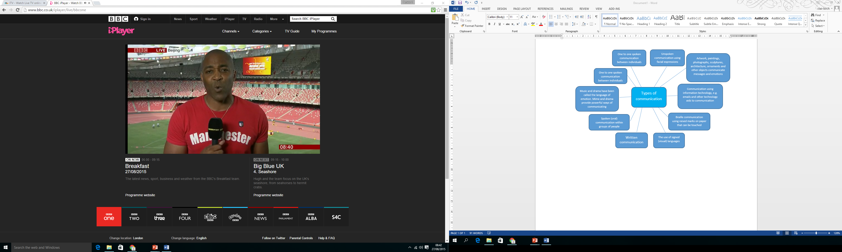

Slide 30
Types of interpersonal interaction
Speech - What do you think of when you read the word “speech” ?
Do you consider:-
dialect,
accent,
colloquialisms (slang),
technical terminology (jargon),
(first language) English as a second language.
Activity:
For each of the above give a suitable example of when communication is positive and an example of when it is negative

Slide 31
Non verbal
Activity In threes
Plan a short conversation and 2 people will deliver it.
Whilst they are talking the observer will check their non-verbal communication by using the table.
Then complete the same activity in a larger group.

Slide 32
Eye contact | How often do you make eye contact with the person you are talking to? Do you stare at them or do you avoid looking into their eyes? How do you feel when the person looks at you?
Facial expression | Does your face reflect what you are saying? Are you too inexpressive, showing little emotion? Are you over-exaggerating or feigning your interest?
Posture | Does your body look too relaxed? Are you too still and rigid? Are your arms or legs crossed? What are you doing with your hands? Are you facing the person you are talking to?
Touch | Do you touch the person you are talking to? Why do you touch them? Could this be interpreted differently by the other person?
Silence | Are you talking non-stop? Are you allowing enough time for the other person to respond? Are you waiting too long before giving your own response?
Proximity | Are you standing/sitting too close or too far away?

Slide 33
Interpersonal interaction sheet
Activity In pairs
1. If an elderly client was feeling upset, would you give them a hug?
2. You are in a meeting with your team leader and a client you support. Where would you sit in relation to each other?
3. A young child you are looking after falls over and scrapes their knee. How would you respond?
4. An adult with learning difficulties slaps your hand away as you try to help them fasten their coat. How would you respond?
5. An elderly client has soiled himself but is refusing your help to clean him up. What would you do?
Extension
Research the work of Edward Hall (1966) into personal space.
You may also want to look at research into gender differences (e.g. Fisher and Byrne, 1975) and cultural differences (e.g. Smith, 1979).
Personal space
Close relationships
Personal space with friends
Public space

Slide 34
Gestures and body language
The following are mixed up. Draw a line from each non-verbal cue to its correct explanation.
Hands on hips Open and relaxed
Sitting with legs crossed Authoritative
Sitting with legs apart Lack of self-confidence
Arms crossed on chest Defensive
Hand on cheek Openness, sincerity
Touch or rubbing the nose Boredom or defensive
Rubbing the eye/s Disbelief, doubtful
Open palm/s Lying, doubtful
Touching hair Thinking, evaluating
Steepled fingers Aggression or readiness
Stretch
Next time you watch a TV programme practise identifying what people are really saying through their body language.

Slide 35
Reflective listening
Mirroring
Mirroring is a simple form of reflecting and involves repeating almost exactly what the speaker says.
Mirroring should be short and simple. It is usually enough to just repeat key words or the last few words spoken. This shows you are trying to understand the speakers terms of reference and acts as a prompt for him or her to continue
Paraphrasing
Paraphrasing involves using other words to reflect what the speaker has said. Paraphrasing shows not only that you are listening, but that you are attempting to understand what the speaker is saying.
It is often the case that people 'hear what they expect to hear' due to assumptions, stereotyping or prejudices. When paraphrasing, it is of utmost importance that you do not introduce your own ideas or question the speakers thoughts, feelings or actions. Your responses should be non-directive and non-judgemental.
Reflecting is the process of paraphrasing and restating both the feelings and words of the speaker. The purposes of reflecting are:
To allow the speaker to 'hear' their own thoughts and to focus on what they say and feel.
To show the speaker that you are trying to perceive the world as they see it and that you are doing your best to understand their messages.
Activity:
In pairs
Have a go at reflective listening:
Take turns using the two techniques.

Slide 36
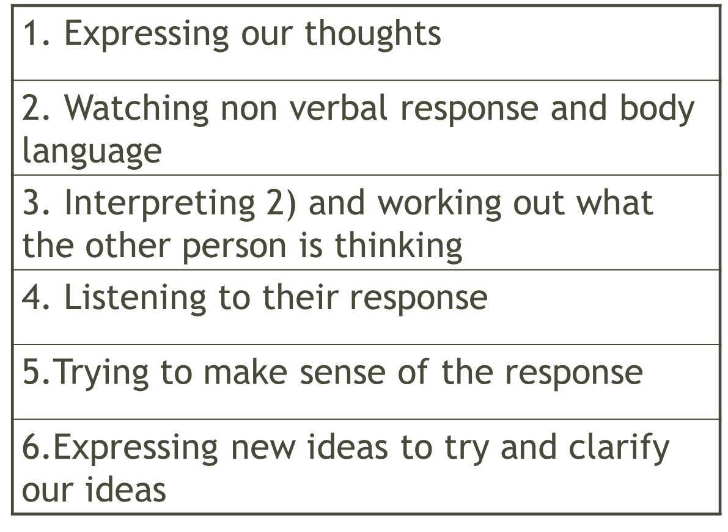
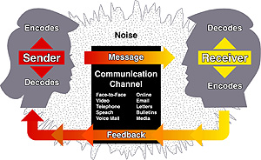
Communication cycle

Slide 37
Communication and language needs and preferences
There are a variety of different ways to communicate; can you think of any?
  BSL.
  Makaton
  Braille
  Signs and symbols
  Written communication
Activity
In pairs research one of these communication pathways . Then present your findings to the class in a poster format.

Slide 38
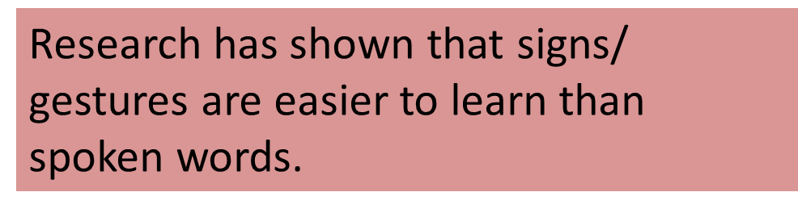






Makaton
Makaton is designed to help hearing people with learning and communication difficulties, it is an aid to communication not a language as such
Makaton was developed in the 1970s to help people with learning disability to communicate.
Makaton is unique because it combines signs, symbols, and speech to provide multi-modal communication
Makaton uses speech together with a sign (gesture) and/ or a symbol (picture),
The Makaton programme can be used with autistic children and adults and is recognised as a useful method of developing communication.
Makaton can help if a child has difficulties with understanding and speaking.
People who can’t speak often become withdrawn
They may communicate through behaviours like shouting or harming themselves
By using Makaton, it can help them communicate in a more acceptable way

Slide 39

Frequently asked questions about Makaton…
What's a symbol?
A symbol is a picture used to represent a word
When do you use symbols?
Symbols can be used to develop language and reading skills
Who needs to use Makaton?
We learn to speak by listening to other people speaking. Everyone needs to learn signs/ symbols and use them as much as possible to help the person communicate.
http://www.makaton.org/about/users.htm/

Slide 40
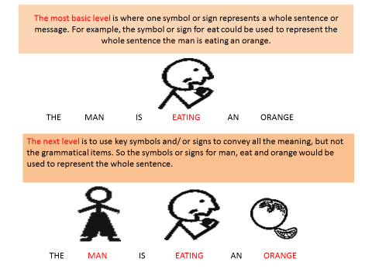
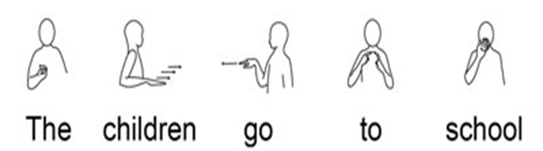
Frequently asked questions about Makaton…

Slide 41
British Sign Language
British Sign Language (BSL) is the name of the sign language which is used in the United Kingdom. It is the first language of approximately 150,000 Deaf people in the British Isles. Thousands more who are not Deaf (such as employers of Deaf people, relatives/friends and interpreters) use BSL.
BSL users campaigned for BSL to be recognized as an official language and it is now recognized like the other languages of the United Kingdom such as Welsh and Gaelic.
BSL is a visual-gestural language without a conventional written form. It has its own grammar utilising facial expression (non-manual features), hand shapes and upper body movements to convey meaning. It’s also a spatial and visual language. BSL is not mime and the grammar used in BSL is completely different to that used in English.
Sign language can vary from country to country even among those whose first language is English. BSL is different to American Sign Language (ASL), Irish Sign Language (ISL) and Northern Ireland Sign Language (NISL) despite them all originating from English-speaking countries.
However, British, Australian and New Zealand Sign Language are very similar due to their use of the same grammar, manual alphabet and high degree of lexical sharing (overlap of signs). The term BANZSL was coined to suggest they are actually dialects of each other. About 82% of their signs are identical.
BSL also has regional dialects. Some signs used in the northern parts of England may be different to those used in the south. Within some regions, you will also find ‘local signs’ that can be classed as ‘slang’ that can go in and out of fashion. Numbers and days of the week often have regional differences. However, it doesn’t really matter which you learn as they are all ‘right’.
Regional signs exist because of regional isolation. Until recently, Deaf people in the UK were relatively isolated. There is no way to send letters in BSL (as it has no written form) and BSL cannot be used over the telephone. If a signing community developed a sign, no one outside of that community would know about it. Schools for the Deaf often had their own signs which children carried with them through adulthood.

Slide 42
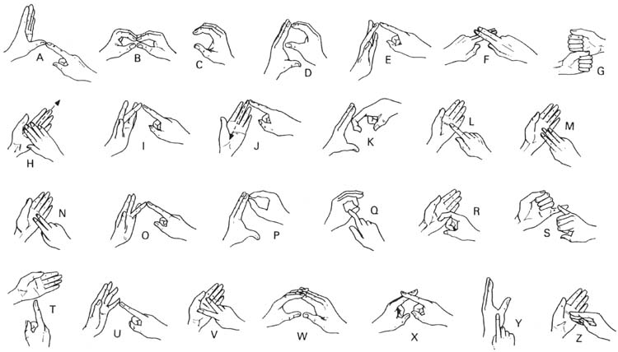

Slide 43
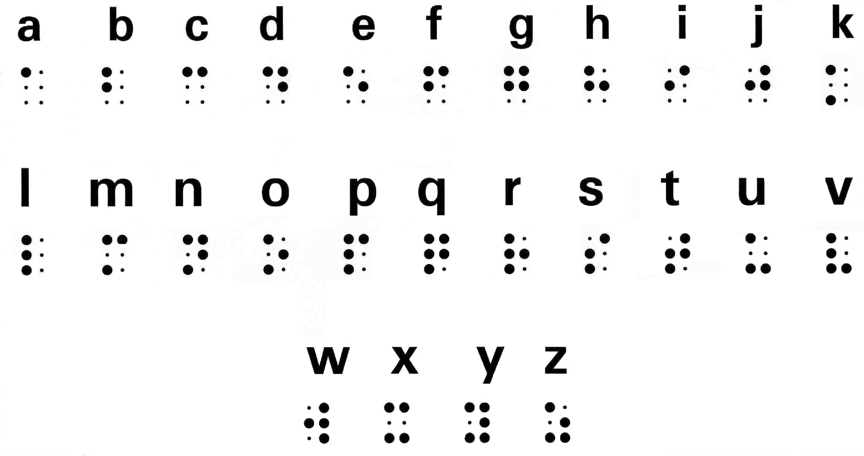
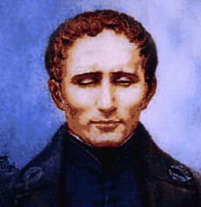
Braille
Louis Braille was born on 4 January 1809
Lousi Braille was born in Coupvray, a small town near Paris, France.
His father was a shoemaker and the young Louis enjoyed playing in his father's workshop. One day, while his father was not watching, Louis accidentally punctured his eye with an awl, a sharp tool used to punch holes in leather. Infection eventually set in and spread to his other eye, leaving Louis completely blind.
Louis Braille invented a tactile alphabet for the blind.
In 1829, Louis Braille published the Method of Writing Words using six raised dots to represent the standard alphabet. The system of raised dots is called Braille and enables blind people of any age to read with the tips of their fingers.
People read Braille by moving their fingertips from left to right across the lines of dots. The raised dots represent the letters in the alphabet as well as punctuation.

Slide 44
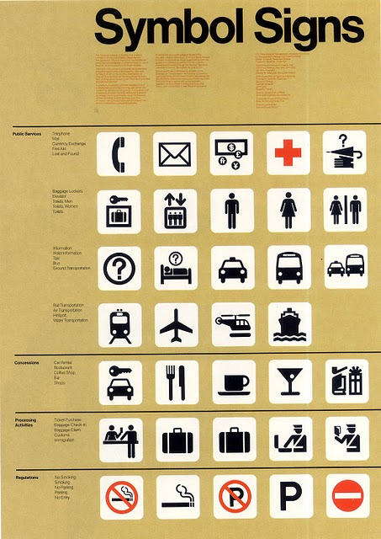
Signs and symbols
Universal images have been used throughout the centuries to inform people.
Look at these signs:
Where might you have seen these before?
On a foreign holiday useful to have the signs used In the UK abroad as a universal sign everyone knows what they mean even if they cannot understand the written sign

Slide 45
Communication passports
These are used to support people in everyday life .
They are often used to enable them to communicate with other people they come into contact with.
They are often visual with signs and symbols.
But may have a story to them informing the person reading it a little about the individual which can help them to understand more about them without having to ask lots of questions
These books are normally made either by the individual themselves or with the support of another person.
The main idea is to support the individual and give them a voice.

Slide 46
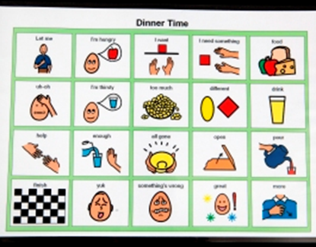
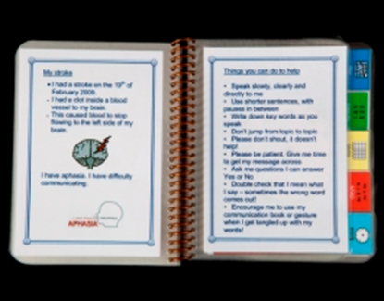
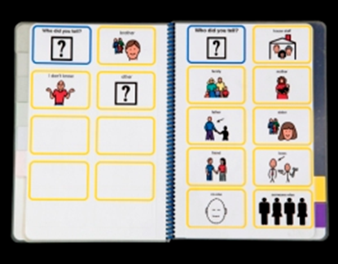
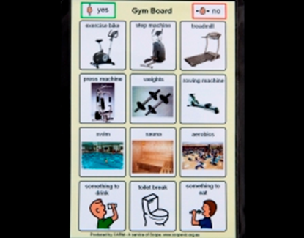

Slide 47
Unit 1 BTEC Level 3 LO2
Barriers
Theories of communication
Understand factors that influence communication and interpersonal interaction in HSC environments
Factors: E.g. types of communication ( difficult, complex, understood) Language needs/preferences, sensory impairment, disability, personality, self-esteem, anxiety, depression, aggression, submissiveness, assumptions, value and belief systems, jargon and cultural variations, use of power, effects of alcohol/drugs.
Argyle’s stages of the communication cycle
(ideas occur, message coded, message sent, message received, message decoded, message understood)
Tuckman’s stages of group interaction (forming, storming, norming and performing)
Environment
Factors (e.g. setting, noise, seating, lighting, space, time)

Slide 48

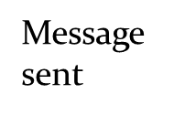
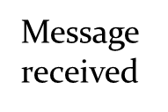

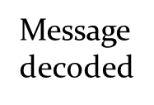
Argyle
Michael Argyle (1925 – 2002) was a Social Psychologist who researched and developed the theories about human communication and interpersonal interaction. Argyle proposed that communication is a skill which needs to be learnt and practiced like any other skill.
He looked at both verbal and non-verbal communication.
His experimental research was to develop the theoretical image which became the Communication Cycle theory.
Argyle in (1967) claimed that human communication is essentially a two way process that involves people sending, receiving and responding to each others non-verbal and verbal messages.
2
3
4
5
6
1
Message coded

Slide 49
Argyle’s Communication Cycle
Throughout the process of the cycle information is received or given. This process is repeated to develop into the Communication Cycle
What if there is a break in the cycle?
What would be the effect?
In groups give some examples…

Slide 50
Argyle’s communication cycle when communication goes wrong…
2
3
4
5
6
1
Message sent
Inaudible illegible or by
inappropriate methods
Idea
occurs
Message coded
Inaccurate or vague
Message decoded
Wrong language,
Non-VC misunderstood
Message
misunderstood
Message received
Not heard, seen
or read properly

Slide 51
Activity
Take it in turns to talk to each other about a health-related subject for 1 minute. Whilst the speaker is talking the listener should avoid listening and not pay attention. The speaker should keep talking during this time and the listener should stay seated.
After each person has spoken, take turns to tell the other person what you liked and disliked about the activity.
Try to identify the main factors that inhibited or disrupted the communication process.

Slide 52
Communication cycle case study
Extension
Using the case study to illustrate your answer, identify the different stages where communication could go wrong. What could happen if communication was not effective in this instance?
Read the case study then break it down into the 6 stages of communication:
Mary is a young adult with mild to moderate learning difficulties who lives in a domiciliary care unit. She woke up not wanting to go to college this morning and needs to find a way to communicate this to her support worker,
Melanie. She decides how she is going to send this message to Melanie, who is already at the unit to help Mary get ready. As usual, Melanie knocks to remind Mary to wake up and start preparing for college.
Mary decides to ignore her support worker and doesn’t get out of bed. Melanie knocks again but Mary still refuses to get out of bed. Melanie knows that, if Mary wanted to go to college, she would usually be ready by now. She realises that Mary is trying to send her a message – a sign that she doesn’t want to go to college. To clarify that she hasn’t misread Mary’s non-verbal communication, Melanie
then asks Mary whether, by staying in bed, she means that she doesn’t want to go to college. Mary nods her head.
Identify the six stages of the communication cycle in the case study.
1 Idea occurs:
2 Message coded:
3 Message sent:
4 Message received:
5 Message decoded:
Message understood
How did Melanie check that Mary understood the message?

Slide 53
What went wrong / right in these situations?
https://www.youtube.com/watch?v=8GlQgJ-RPcU Holby City
https://www.youtube.com/watch?v=sbSeqGjftHI Doc Martin

Slide 54
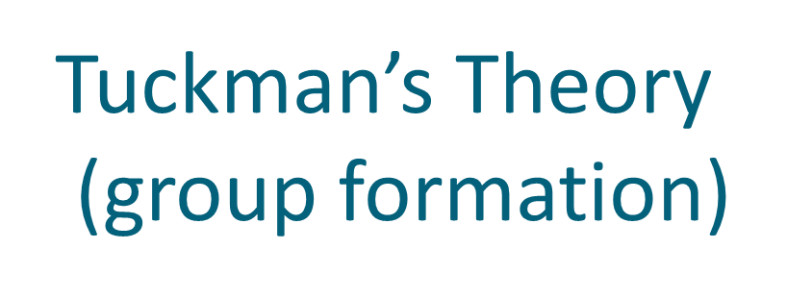
Four stages:
Forming
Storming
Norming
Performing
Adjourning has also been suggested as a fifth stage (the group stops activities and finds an acceptable way for group members to part).
Bruce Tuckman (1965) developed a model of group development based around a number of stages, or sequence, of group activity.
Tuckman suggested that groups must go through a series of changes to be effective in the communication process and they have to be effective in each stage to move on to the next.
He further suggested that the type, patterns of communication used in each stage is different.

Slide 55
Forming
An introductory stage.
People may be unsure about why they are meeting.
Anxiety at the process and the group interactions/composition
Purpose of group may not be clear.
May be little commitment.
Can be a lack of values and stereotyping/ prejudice may be expressed.

Slide 56
Storming
May be power struggles/conflict.
Arguments about how the group works, who does what etc.
At this stage groups may fail and people may drop out.
Teams may split into sub groups who refuse to communicate with each other and become stuck in this stage.
Co-operation towards the end of this stage should begin to develop.

Slide 57
Norming
Members develop a set of common beliefs and values.
Trust develops.
Clear roles set out.
People have shared expectations of each other (norms).
The group becomes more cohesive and group members work together to resolve conflict.

Slide 58
Performing
People share the same values and norms.
Group can perform tasks effectively.
People may feel that they are comfortable and able to belong in the group.
May be a sense of high morale.
Mutual support for each other/group members

Slide 59
Activity
Individually
Imagine you are visiting a new GP surgery. It is the first day it has opened, and the first day all the staff have started to work there.
What problems are likely to occur?
What effects will they have on the service user?
What could the managers do to avoid them?

Slide 60
Tuckman’s group formation theory
1. A group of six health advisers has been employed by the local council to put together a healthy- eating campaign aimed at children. These advisors have never met before. Marcus, a member of the group, is aware of Tuckman’s group formation theory and is interested to find out whether the health advisors will follow the predicted patterns of performance.
Using the table below, identify the general characteristics of each stage in Tuckman’s group formation theory.
Using the scenario above to illustrate, show how this group might go through the four stages of Tuckman’s theory and predict what could happen at each stage.
Tuckman’s group formation stages | General characteristics of each stage | Illustration of what might happen at each stage
Forming
Storming
Norming
Performing

Slide 61
Tuckman’s group formation stages | General characteristics of each stage | Illustration of what might happen at each stage
Forming
Storming
Norming
Performing
2. Beverley, one of the health advisors, is due to go on maternity leave part-way through the project. What effect will changing members within the group have on the performance of the group? Will it make a difference when Beverley goes on maternity leave? Give reasons for your answers.
3. For group communication to be effective, describe at least three things the group members should do.
Extension
Explain how the structure of a group can affect communication within it. You can use the scenario to illustrate your point.

Slide 62
Scenarios
How would these situations effect communication in a health and social care setting?
After each write on your chart how these effected communication
Scenario - noise
http://www.youtube.com/watch?v=VbvB4k7DT6o
Scenario - angry
http://www.youtube.com/watch?v=X-zft3SAiTY
Scenario - Distress
http://www.youtube.com/watch?v=TPFtxMH5TCg

Slide 63

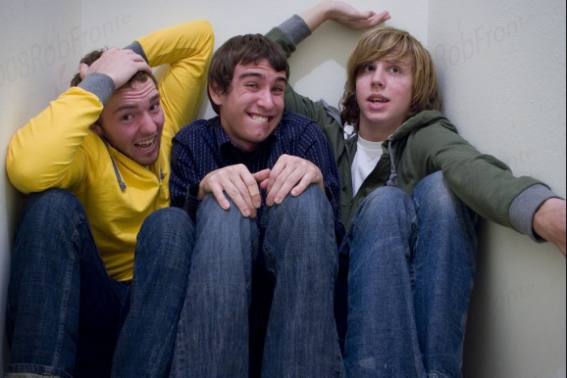
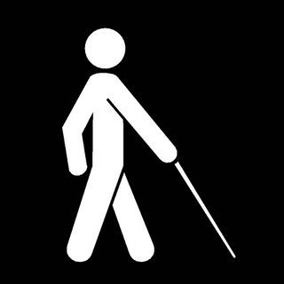
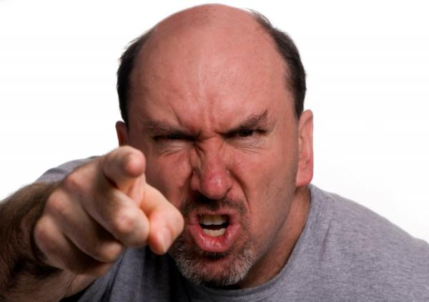

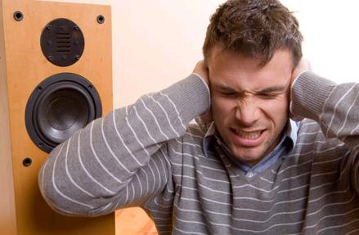

How would these effect your communication?
Sensory problems
Dark room
Small space
Angry person
Foreign language
Loud noise
Distress

Slide 64
Environment
The factors we are looking at are:
Physical
Emotional
Social
Communication skills
Individual needs
Activity
In pairs, identify how each factor could improve and decrease communication. Write your comments below, one example has been done for you.
When you are trying to communicate with someone there are a number of things (factors) which can make communication better or worse. Such as:
1) The room being too hot so you get sleepy.
2) Music being on too loud so you can’t hear the other person

Slide 65
Activity on Environmental factors
Note: all should relate to a HSC setting
Factor | Way it improves | Way it decreases
Physical Environment
Emotional Factors | The person is very outgoing which makes them very talkative. | The person is very shy and not confident at joining in, or starting, conversations.
Social Factors
Communication Skills
Individual Needs

Slide 66
Activity:
Read the case study on the next slide and identify and explain the following:
What environmental factors influenced this communication?
How could these factors be overcome?
What other factors can you see?
Make sure you say how they are influencing the service user in your answer.

Slide 67
You are observing a multi-disciplinary team (MDT) meeting where Mrs Singh is due to be discharged home following major bowel surgery. Present at the meeting are Mrs Singh and her husband, the ward nurse, the district nurse, the social worker, the doctor, a physiotherapist, a dietician and an occupational therapist. The meeting is to organise a discharge package for Mrs Singh and is held in the ward day room at lunchtime. The MDT are all seated around the table on high chairs whilst Mrs Singh and her husband are sitting in lower ‘patient’ chairs. Mrs Singh and her husband speak minimal English. There is a lot of background noise from the ward and the light in the day room is flickering. The ward nurse begins the meeting and has to raise her voice to be heard over the environmental noise. She appears rather aggressive. The MDT begin to discuss Mrs Singh and use a lot of medical terminology. The conversation speeds up as time is limited and the doctor needs to leave imminently and does not appear interested. You notice that Mrs Singh and her husband look slightly bewildered and are nodding their heads intermittently.
Eventually the MDT agree on the care package that they deem to be appropriate and ask Mrs Singh and her husband to agree to it. They thank the MDT and leave looking extremely confused.

Slide 68
Barriers to communication
Communication can also be stopped dead in the water. This is what barriers do, stop things, just like a road barrier stopping you driving down a road. An example of a barrier to communication is the person being in another room. A strategy to get over this is to text or call them.
Activity:
In pairs look at the examples and list the barriers to communication.
Scenario 1: Jess arranges to meet her friend in a popular and overcrowded night club.
Scenario 2: Mark and James are in a three hour lesson.
Scenario 3: Angie is driving to work and spots, notices that a fellow motorist has excessive smoke coming out of the car.

Slide 69
https://www.youtube.com/watch?v=8Ox5LhIJSBE

Slide 70
Factors that influence communication barriers
Activity In Pairs
For each of the barriers given identify possible strategies health care professionals would use to overcome these
Type of barrier | Possible strategies
Service user suffers from a sensory impairment, e.g. deaf.
The service user has low self-esteem and is depressed.
The individual is stressed (anxiety attacks)
The service user is being aggression to yourself.
They assume that you are useless because of your gender.
A doctors tried to explain a problem but they are using to much jargon.
Your boss is abusing their power and making you do jobs which you are not meant to do.
The service user is under the influence of alcohol or drugs

Slide 71
Communication and interpersonal interaction
Activity Individually, for each of the barriers listed, consider possible strategies for overcoming it…
Communication that involves difficult, complex or sensitive issues
Unmet language needs or preferences
Sensory impairment
Disability
Personality or self-esteem needs
Anxiety or depression
Aggression/submissiveness
Assumptions, values or beliefs
Jargon
Cultural variations
Abuse of power
Alcohol or drugs

Slide 72
Factors that influence effective communication in different service-user groups
Select a service-user group (for example, children, elderly people or those with learning difficulties) and consider communication barriers that are specific to that group. Complete the table below.
Barriers to communication and interpersonal interaction | How can this barrier affect your service- user group? | What can be done to reduce the negative influence of this barrier? | Using your chosen service-user group, give an example to explain
Environmental factors (setting, noise, time, lighting, space)
Type of communication (difficult, complex, sensitive)
Language needs and preferences
Cultural variations
Disability or impairment (learning, hearing, visual)
Emotional barriers (poor self-esteem, depression, anxiety)
Abuse (physical, mental, financial, neglect)

Slide 73
Unit 1 BTEC Level 3 LO 3
Aids to communication
Communication and interpersonal interaction
Human :- advocates, interpreters, translators, mentors, befrienders, technological aids (hearing aids, text phones, Mincom, voice activated software, relay systems, loop systems)
Understand ways to overcome barriers in a HSC environment
Possible strategies , e.g. staff training, assessment of need, using preferred method, promoting rights, confidentiality, defusing aggression, assertiveness, appropriate verbal/non verbal communication, building relationships, appropriate environment, attitude, confidence.

Slide 74
Staff training
This is a vital part of any job within HSC professionals and should be ongoing.
Staff are given initial induction courses on starting with an organisation.
Staff are then often given further training on specific factors around the individuals they will be supporting.
Often staff are given specific training on individuals who have specific communication types.

Slide 75
Assessment of need and preferred method of communication
The specific needs of a person
Professionals will need to make an assessment of the persons individual needs and ensure that all other professionals are aware of these needs - communication.
This also allows their preferred method of communication to be used.

Slide 76
Promoting rights
The Human Rights Act (1998) is designed to support all individuals
All services that are involved in Health, Social care and Early years also promote the rights of the individual through their codes of practice and policies
Confidentiality

Slide 77
Promoting rights
To be protected from danger or harm
To be treated as an individual
A service user’s rights
To be cared for in a way that meets their needs and takes account of choices
To be given privacy
To be treated in a dignified way
To be respected
To be able to communicate using their preferred method
To be allowed access to information about themselves
To be treated equally and not discriminated against

Slide 78
AS 10 Assertiveness
1. Write a short summary of each of the following behaviours.
Aggressive:
Assertive:
Submissive:
2.Read the following scenarios and decide on responses that would be aggressive, assertive and submissive.
Scenario 1
A colleague rings you up while you are talking to a new client. Your colleague wants to talk about a meeting set up for next week about another client and is quite insistent.
Aggressive response:
Assertive response:
Submissive response:
Scenario 2
Your boss has criticised your communication skills, stating that a number of clients have complained that you have been rude to them. You disagree with this and believe your boss is being unfair.
Aggressive response:
Assertive response:
Submissive response:

Slide 79
AS 11 Assertiveness

Slide 80
Aids to communication in health and social care settings
Aid | Human or technological aid | Function | Type of service user who would benefit from this aid | The advantages of using this aid | The possible disadvantages of using this aid
Advocate
Interpreter
Translator
Mentor
Befriender
Hearing aid
Voice activated
Software
Minicom

Slide 81
Case Studies
Liam: You can’t possibly understand what it feels like to be me. Absolutely everything is wrong with my life, I’ve got no reason to be alive and you can’t help me – what’s the point of talking?
Carer: But perhaps I could be useful if I knew more about your life?
Liam: What do you want to know? I’ve got no money, no job, no future, no one cares about me – there’s no point in going on.
Carer: Right, so it feels really terrible, really bad, but was there a time before things went wrong – a time when you were happy?
Liam: Yes, a few years back everything was good – but now I feel even more miserable because you are reminding me of how much I’ve lost!

Slide 82
Can you remove the barrier?
Influence self esteem
Keep conversation going
Open Q’s
Reinforce can be happy again etc.
Would these strategies work?
Why/ Why not?

Slide 83
Gerard
Gerard is a tall, muscular, middle-aged man
who regularly talks to staff about his son’s care.
He prefers to stand squarely face-to-face and
speaks quickly, using a loud voice. Staff say that
they feel uncomfortable talking to Gerard because
he sometimes ‘stares at you’ with a fixed gaze.
Staff say ‘He is in your face’ because they feel that
he stands too close to them. Some staff think that
Gerard is aggressive and demanding because of the way he acts.

Slide 84
Bill
Bill is a resident in a care home, who has been diagnosed with dementia. Tony is a care worker who knows Bill well. Bill will sit for long periods of time and
then become agitated. While sitting in his chair he has started to shout angrily at other residents.
Bill (very angry): You lot can get out of here, I don’t want you round here anymore.
Tony (calm and gentle tone of voice): Hello Bill, I am going to bring some coffee around in a minute. Would you like a cup?
Bill (raising his fist): You can get out of here too. Go on, get off or I’ll have you!
Tony (stepping back and lowering his head in a non threatening way): Bill, you remember me. You told me about your time in the Merchant Navy back in the fifties.
Bill (still angry): Don’t remember you – you weren’t there!
Tony (calm, gentle, serious): No – but you told me all about your time on the Sea Princess. How you went to South America, how you met your first wife.
Bill (less angry but accusing tone): How do you know all that about me? Have you been spying on me?
Tony (serious, sincere but calm): No Bill, honest, I would never spy on you. We had a long talk yesterday and I really enjoyed hearing about all the things you used to get up to. I was really interested – you’ve lived an exciting life. I was wondering whether you might have time to tell me a few more stories?
Bill (calmer tone of voice): Well, what about all these people in here?
Tony (expressing genuine interest): We could leave them for the moment – tell me more about your
time in South America.
Bill (calm): Not sure I can remember, what were we talking about?

Slide 85
Gloria
Gloria grew up in the Caribbean and came to the UK 60 years ago. She now lives in a residential care home because she has developed some memory loss and disorientation associated with Alzheimer’s disease. Gloria also has some hearing loss and uses a hearing aid. Gloria’s first language is English but care workers sometimes have difficulty understanding her speech. Sometimes Gloria will talk about places and events from the past that care staff have difficulty identifying with. Some care staff think that Gloria is ‘confused’ and that trying to communicate with her is a waste of time. Gloria sometimes becomes distressed because she is lonely and there is no one to talk to.

Slide 86
Unit 1 BTEC Level 3 LO 4
Contexts
Be able to communicate and interact effectively in a HSC environment
Effectiveness
Formal: one to one, group, with people using services, with professionals and colleagues
Group, one to one situations, e.g. awareness of needs and preferences, interpersonal skills, overcoming barriers, adjusting interactions, assertiveness.
Communication skills
Verbal and non verbal: E.g. listening and responding, tone, pace, language, appropriate environment, proximity, clarifying or repeating, questioning, responding to difficult situations, defusing anger.

Slide 87
Starter
Pick 3 of these terms for Bingo
All these terms are important and should be used in your interactions
Barrier | Encoding | Decoding
Transmitting | Receiving | Vocabulary
Tone | Active Listening | Body Language
Slang | Jargon | Eye Contact

Slide 88
Contexts / Communication skills / Effectiveness
Poor teamwork and communication:
https://www.youtube.com/watch?v=nNHNEoWUmm8
Activity
Individually
You will produce a series of short interactions which demonstrate effective skills, covering the following scenarios :-
  One to one
  Group
  With people who use services
  With professionals/colleagues
Each of these need to show effective communication skills ensuring that any meaning was transferred and decoded correctly to all concerned in the scenario.

Slide 89
Communication/context | Analysis prompts
One to one | How did you start and finish your interaction? Did you try to meet the person’s emotional needs? Could you identify a communication cycle involving feedback on your understanding of the other persons ideas?
Group interaction | Were you able to take effective turns in speaking? Could you identify group values and/or purposes within the group? Was there a group leader? How was the interaction managed?
Context | Who was involved in the interaction? People who use services? Professionals? Colleagues? What role did you play?
Verbal listening and responding skills | How effective was your use of language, pace of speech and level of formality? Was there any use of specialist language? How far did you encourage others to talk?
Non verbal listening and responding skills | How appropriate was your tone of voice, facial expression, eye contact and proximity?
Reflective listening skills | How did you use reflective listening and the communication cycle ? Can you identify examples of clarifying your understanding or repeating important ideas?
Questioning skills | Did you keep the conversation going using open questions? Can you identify probes and prompts that you used?
Environment | Did the environment create any barriers? Could everybody see and hear each other clearly?
Barriers | What barriers did you detect? Were there any barriers to interpreting communication, such as language differences? Were there any barriers to understanding, such as cultural differences, assumptions values or beliefs?
Difficult situations | Did you act in a clam and respectful way? What skills did you use to interact with people with strong emotions?
Defusing anger | Were you able to act in an appropriate, clam and respectful way? Were you able to avoid triggering aggression? Were you able to use assertive skills appropriately?

Slide 90
WAGOLL
P5 - participate in a one-to-one interaction in a health and social care context
My first interaction took place at an access class based in Rivington and Blackrod High school. This was a one to one interaction, this is based on Argyle’s communication where messages are sent, decoded and a response is given. For my interaction I helped a student with their work, called Daniel* with their work. I have changed Daniel’s name to protect confidentiality and therefore uphold the care value bases. The lesson was based on the Death Penalty and Euthanasia. This student was male and in year 9, he was quite talkative with me considering he didn’t know me before. The teacher introduced me to him and told him I was in sixth form, we had a conversation about his opinions on these sensitive subjects and I helped guide him to an answer if he wasn’t sure. This is also an example of the communication cycle taking place as our conversation was an example of sending and receiving messages to one another through verbal communication. The cycle begun on my interaction by my idea to send a message through verbal communication to interact with Daniel, and this was then heard by him. This is an interpersonal skill as Daniel’s response was adapted to suit what my message said, which was a conversation on the death penalty. This skill is learned, and can be developed throughout life. During our interaction, Daniel went off topic and started talking about the films he liked when “The Green Mile” was mentioned – this could show that he felt comfortable and able to talk to me, but also could suggest that his communication cycle skill had not become skilfully interpersonal yet as the conversation topic suddenly changed.

