Slide 1
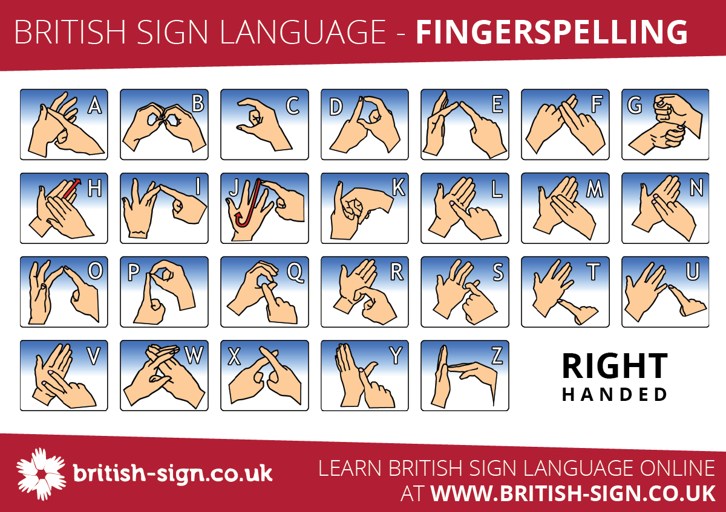
BSL – British sign language
British Sign Language is a sign language used in the United Kingdom, and is the first or preferred language of some deaf people in the UK.

Slide 2
BSL isn’t simply English with hand signs, it is a different language with its own grammar and sentence construction. While you would say “what is your name?” in English, a BSL user would sign, “your name, what?”
Most Deaf people who use British Sign Language, It’s a rich combination of hand gestures, facial expressions and body language
You might assume that sign language across the world is the same – but actually British Sign Language is totally different to other sign languages such as American Sign Language or Japanese Sign Language

Slide 3
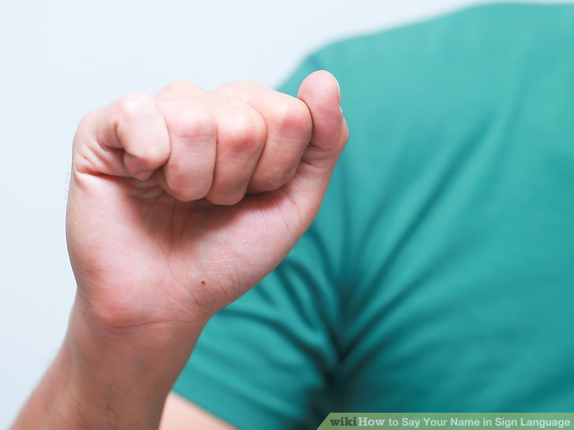
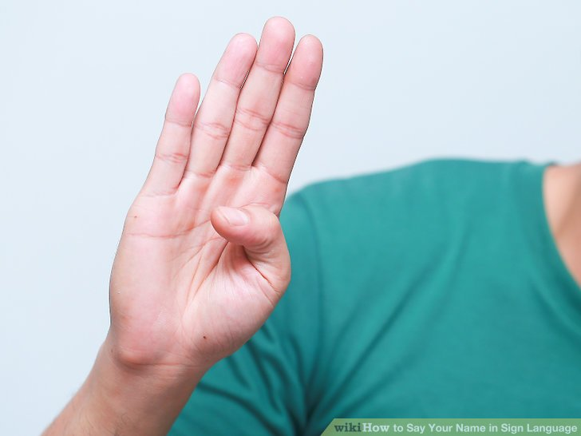
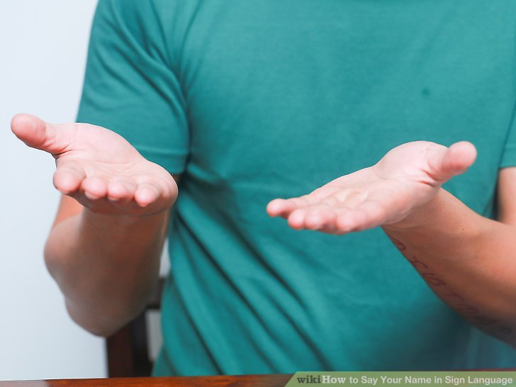
How to say your name in sign language
Hi
My
Name
Is
Moizza

