Slide 1
B2: Barriers to Accessing services
What type of barriers are there, when service users try and use a service like a doctors, a dentist or physiotherapist?

Slide 2
Specific needs
Learning disabilities
Physical disabilities
Sensory disabilities
Mental health illness
Older people
Children
Refugees

Slide 3
Individual preferences
Religious or cultural preferences
Women who prefer to be treated by a woman
People with a terminal illness who refuse further treatment
Older person who wishes to remain independent

Slide 4
Other barriers to accessing health and social care
Language
Geography
Financial
Lack of resources
Communication

Slide 5
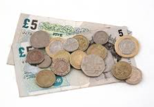
Financial Barriers
On benefits or a low income
Disabled taxi costs more
Prescription costs
Bus fares
Child care costs
Taking time off work, unpaid
Eligibility to free prescriptions and service are offered depending on financial status and in addition there is charity support and volunteers as well as subsidised parking fees

Slide 6
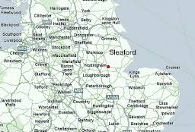
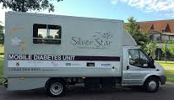
Geographical
Live rural and not near any services
Not many people use the service so it closes
Opening times do not suit
Poor weather stops access

Slide 7
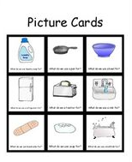
Language Barrier
Aphasia
Speech impediment
Doctors medical jargon
Illiterate
ESOL

Slide 8
Psychological barriers
Bad past experience
Agoraphobic; afraid to go out
Panic attacks and phobias
Fear of the diagnosis
Afraid of service dentist/doctor
Afraid of treatment, injections

Slide 9
Resources and Untrained staff
The NHS funds are stretched and that of social services, so sometimes resources are scarce
Long waiting times
Lack of beds
Bed blockers
Restricted opening times
Text reminders for appointments, NHS paying for private treatment, elected operations cancelled, hospitals on red alert

