Slide 1
Starter
At what point is someone ‘old?’
Why is it getting harder to determine the beginning of ‘old age?’
What is meant by the term ‘life expectancy?’

Slide 2
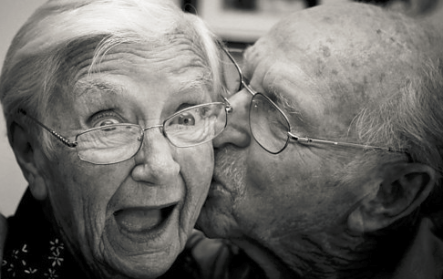
Development During Later Adulthood
To know physical and intellectual changes in later adulthood
To complete practice exam questions on growth and development

Slide 3
How much do you know about old age?
I am going to ask you some questions about old age and some issues in old age development.

Slide 4
1. How many people in the UK are aged 65 or older? (2016 Age UK stats)
10.8 million
11.8 million
12.8 million
13.8 million

Slide 5
1. How many people in the UK are aged 65 or older? (2016 Age UK stats)
10.8 million
11.8 million
12.8 million
13.8 million

Slide 6
2. What percentage of the 11.8 million are women?
50%
60%
70%
80%

Slide 7
2. What percentage of the 11.8 million are women?
50%
60%
70%
80%

Slide 8
3. On average, how many people in the UK are expected to live to their 100th birthday?
1 in 3
1 in 4
1 in 5
1 in 6

Slide 9
3. On average, how many people in the UK are expected to live to their 100th birthday?
1 in 3
1 in 4
1 in 5
1 in 6

Slide 10
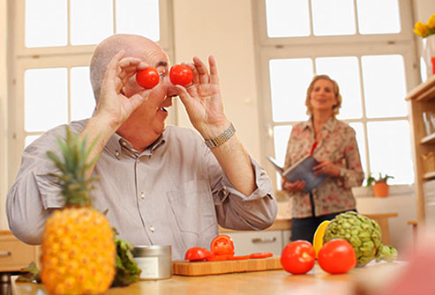
4. Do you think people over 65 are more likely to eat 5 portions of fruit or veg a day compared with those under 65?
Yes
No

Slide 11
4. Do you think people over 65 are more likely to eat 5 portions of fruit or veg a day compared with those under 65?
Yes
No

Slide 12
5. What percentage of men over 65 reported that they are still sexually active? (having sex at least twice a month)
54%
64%
74%
84%

Slide 13
5. What percentage of men over 65 reported that they are still sexually active? (having sex at least twice a month)
54%
64%
74%
84%

Slide 14
6. Between 1998 and 2008 the Health Protection Agency reported what percentage increase in gonorrhoea in women aged 65?
60%
70%
80%
90%

Slide 15
6. Between 1998 and 2008 the Health Protection Agency reported what percentage increase in gonorrhoea in women aged 65?
60%
70%
80%
90%

Slide 16
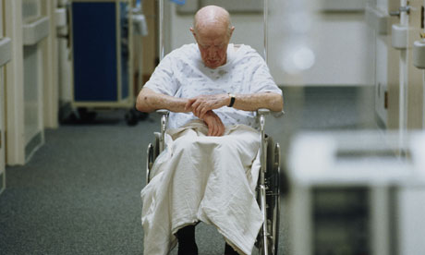
7. Of the 18.7 million people admitted to hospital last year, what percentage were aged 65 or older?
21%
31%
41%
51%

Slide 17
7. Of the 18.7 million people admitted to hospital last year, what percentage were aged 65 or older?
21%
31%
41%
51%

Slide 18
8. On average, what percentage of doctors in the UK are geriatricians?
1%
3%
5%
10%

Slide 19
8. On average, what percentage of doctors in the UK are geriatricians?
1%
3%
5%
10%

Slide 20
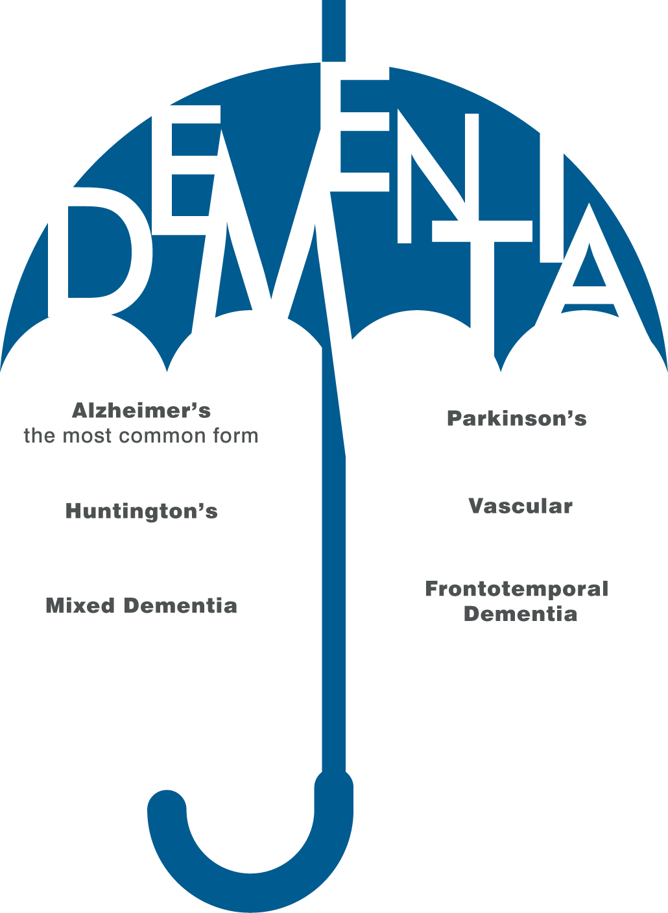
9. How many people over 65 will die with a form of dementia?
1 in 3
1 in 6
1 in 9
1 in 12

Slide 21
9. How many people over 65 will die with a form of dementia?
1 in 3
1 in 6
1 in 9
1 in 12

Slide 22
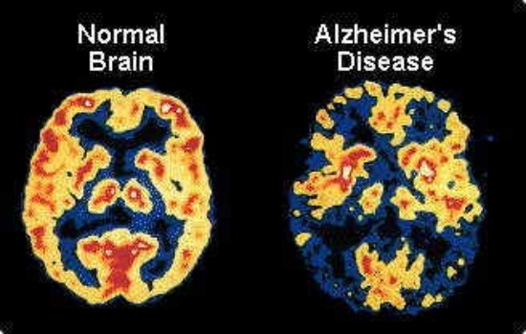
10. Becoming bilingual (even later in life) can delay the onset of dementia by how much?
4 years
5 years
6 years
7 years

Slide 23
10. Becoming bilingual (even later in life) can delay the onset of dementia by how much?
4 years
5 years
6 years
7 years

Slide 24
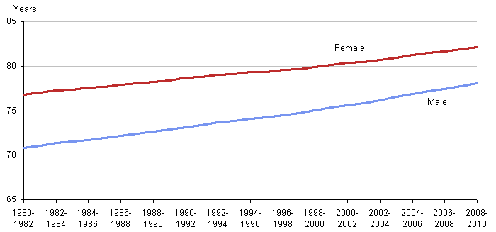
Life Expectancy
Why are people living longer?
http://news.sky.com/story/where-in-england-do-people-live-the-longest-10346323

Slide 25
Task
We will cover old age in more detail later on (Learning Aim C)
1. Read through the information on the sheet and highlight any key terms or important points about development.

Slide 26
Task
2. How does physical health deteriorate in later life?
3. Why don’t all older people experience the same deterioration?
4. How do intellectual abilities deteriorate in later life?

Slide 27
Mini Test
You have 20 minutes to complete the mini test- you cannot use your notes or the textbooks.

