Slide 1
Starter 1
Jan is 48 years of age. He has two children. Oscar is 8 years old and Anna is 18 months old. Anna is meeting the expected developmental milestones for her age.
Explain two possible features of Anna’s physical development at her life stage. (4 marks)
Anna will be able to walk without help because she has developed the muscles in her back and legs.
Anna will be able to build a short tower of blocks because she has developed control over her small muscles in her hands and fingers.

Slide 2
Starter 2
Discuss the importance of monitoring Anna’s growth with reference to centiles. (5 marks)
The health visitor will measure Anna’s height and weight and check these against centiles that show the average for girls of Anna’s age. They will plot this on a centile chart. If Anna is growing more slowly or quickly than expected, the health visitor will offer lifestyle advice or refer her to a doctor.

Slide 3
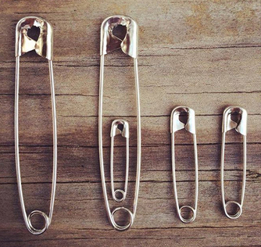
Physical Development During Adulthood
To know physical changes during pregnancy
To be able to describe the perimenopause and menopause

Slide 4
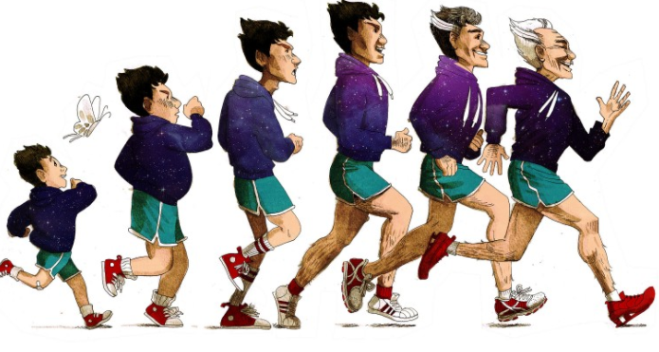
Early Adulthood (19-45)
Adults aged between 19-28 are at their tallest, strongest, fastest and most dextrous.
From around 29 years onwards, however, there is a slight decline in physical capabilities.
What lifestyle factors can impact this decline and make it more noticeable?
Smoking
Poor diet
Lack of exercise
Illness/Disability
Alcohol/Drug Use

Slide 5
Physical Changes During Pregnancy and Lactation
Pregnancy is one of the biggest physical changes experienced during early adulthood.
Two hormones which lead to physical changes are:
Increase in oestrogen- could be the reason some women feel sick in early pregnancy
Increase in progesterone- maintains the pregnancy
https://www.babycentre.co.uk/v25015153/how-your-body-changes-in-pregnancy-video
How else does the body change during pregnancy?
Challenge: Think; what physical changes are needed to prepare the breasts for lactation?
Notes:
Change in appearance of breasts- darkened veins due to increased blood supply, nipples and areolas darken, become sensitive and tender.

Slide 6
Perimenopause
Summing Up Perimenopause Symptoms:
All linked to hormonal imbalances.
Physical
Hot flushes
Night sweats
Vaginal dryness
Fatigue (Sometimes called crashing fatigue.)
Emotional:
Mood swings
Loss of libido
This occurs before the onset of menopause, usually when a women reaches 40+ years old.
Use the computers to research the perimenopause.
You should find out:
When the perimenopause occurs…
The difference between perimenopause and menopause…
How long perimenopause lasts…
Symptoms of perimenopause…
Challenge: Can you think of some emotional effects of perimenopause? How might women feel when they reach this stage?
Notes:
Discussion of student answers then videos for the clarification: http://www.webmd.com/women/video/corio-perimenopause (3 short videos, let it play on) Summing up available for those who want it.

Slide 7
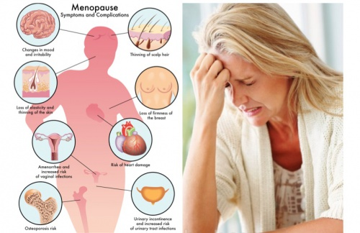
Middle Adulthood (46-65)
Menopause marks the end of fertility.
There is information about menopause on the sheet
Then complete the task:
Task:
1. Read through the information highlight or underline any key terms.
2. The information concerns how menopause affects women physically and emotionally- use notes in the margin/highlighters/underlining to show which information concerns which area of development.
Challenge:
How is perimenopause different to menopause?
Notes:
Challenge answer: Main difference is periods- they are irregular in perimenopause and gradually stop altogether in menopause.

Slide 8
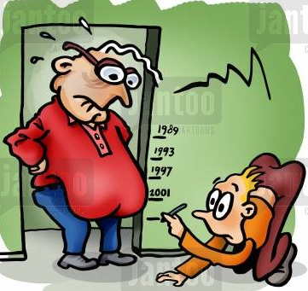
Other Effects of Aging…
Other than the menopause, how do middle adults change physically?
Hint: Think of changes you can easily see in both men and women
Put on weight (middle aged spread) because they still eat the same amount as when they were younger but are less active.
Loss of skin elasticity
Lost of muscle tone and strength
Greying/thinning hair

Slide 9
Now can you…
On the sheet are 2 example answers to this question:
Describe 3 physical symptoms of perimenopause (6 marks)
Tasks:
Mark the answers out of 6
Add an improvement point to any answer that you haven’t given full marks or (if you have given full marks) try to comment on why it was worth 6 out of 6.
Hint: A describe question requires students to demonstrate understanding and recall of knowledge. Split the answer so that each physical symptom is worth 2 marks.

Slide 10
What did the examiners say?
Student 1 | Student 2
6 marks The three symptoms are adequately described however, the point concerning urinary urgency could’ve been linked to increased urinary tract infections. | 2 marks Mood swings are an emotional symptom of perimenopause Vaginal dryness and fatigue are correctly identified physical symptoms but their description is based on opinion and subjective thought instead of being linked to hormonal changes.
Use the 6 mark answer in your revision of perimenopause!

Slide 11
Mini Test
Next lesson we will have a mini test to practice what you have learned so far about development.
Homework is revision!

