Slide 1
Starter:
Daniel is 2 years and 1 month old and his health visitor has arrived to complete his 2 year check.
The health visitor finds that Daniel has gained 2.5kg since she last saw him and tells his parents that this is a normal amount of weight gain. The health visitor asks Daniel’s parents some questions about Daniel; his parents describe that Daniel can now climb onto furniture and throw a ball. The health visitor mentions that most 2 year olds have reached the milestone of being able to draw a line or a circle on paper. Daniel’s parents are worried that he cannot yet do this.
Questions:
How has Daniel grown?
How has Daniel developed?
What is meant by the term ‘milestone’?
Why should the health visitor reassure Daniel’s parents not to worry too much?

Slide 2
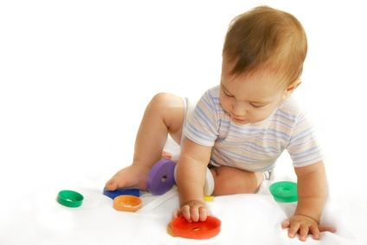
Physical Development in Infancy
To know the life stages
To know the difference between gross and fine motor skills
To know the milestones of physical development in infancy and early childhood

Slide 3
Life Stages:
Test your partner…
One of you turn so you can’t see the board:
Life Stage | Age
Birth and Infancy | 0-2 Years
Early Childhood | 3-8 Years
Adolescence | 9-18 Years
Early Adulthood | 19-45 Years
Middle Adulthood | 46-65 Years
Later Adulthood | 65 Years Onwards
We will be looking at physical, intellectual, emotional and social development across these life stages.

Slide 4
Physical Development in Infancy
https://www.youtube.com/watch?v=L0fFtAvWE3I
Watch this quick clip and write a definition of gross and fine motor skills in your notes.
Now…have a go at this card sort:
1st: sort them into gross and fine motor skills
2nd: put them in order of those which you think are learned first to those learned last
3rd: (challenge) try to assign an age at which you think these physical milestones are learned.

Slide 5
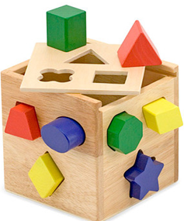
Gross and Fine Motor Skill Milestones in Infancy
Age | Gross Motor Skills | Fine Motor Skills
Newborn | Primitive reflexes such as grasp | Holds their thumbs tucked into their hands
1 Month | Lifts chin, some control of head | Opens hands to grasp a finger
3 Months | Can lift their head and chest when lying on front | Can briefly grasp a rattle
6 Months | Rolls over, can sit up for a short time without support kicks legs when held up | Moves objects from hand to hand, can pick up dropped toys if they’re in sight
9-10 Months | Crawls, begins to cruise | Uses finger and thumb to hold a small object
12-13 Months | Stands alone, can walk without help | Manipulates and places toys
18 Months | Climbs onto furniture | Builds a short tower with blocks
2 Years | Propels a sit-on toy with their feets, throws a large ball | Draws lines and circles, turns pages
2 ½ Years | Jumps from low step, kicks a ball | Uses a spoon and fork, builds tower of 7-8 blocks.
How can this toy encourage the development of both gross and fine motor skills?
Notes:
To be recorded on page 7 of booklet, the toy: gross= infant has to sit up at the toy and support their weight, fine= fitting the shapes into the sorter

Slide 6
Physical Development in Early Childhood
You need to use the computers to research more developmental milestone charts and find out when most children are able to:
Skip
Ride a 2 wheeled bike
Use a knife and fork
Walk along a thin line
Use joined up handwriting
You should also state whether this is a gross or fine motor skill.
Notes:
Skip: 5-6, Bike: 6-7, Knife + Fork: 5-6 years, Thin line: 7-8 years, Handwriting: 6-7 years

Slide 7
Exam Link: 6 mark question
How would you answer this question?
Describe gross and fine motor skills
Link to David- how will they develop? Link both gross and fine motor skills to his ability to grasp objects.

Slide 8
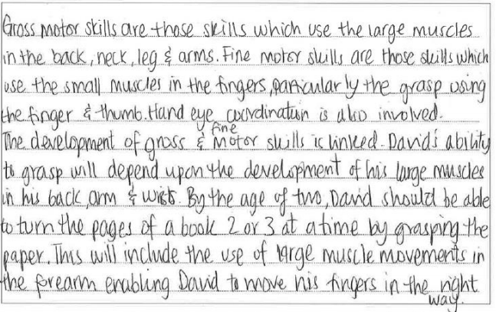
Example of a 6 mark response
Definition of gross and fine motor skills
Gross and fine motor skills are further described in terms of muscles
Link to milestones related to grasping

Slide 9
Example of a 6 mark response
Another link to milestones related to grasping

