Slide 1
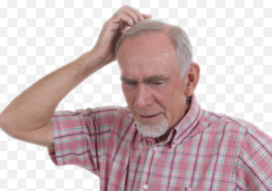
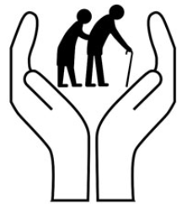
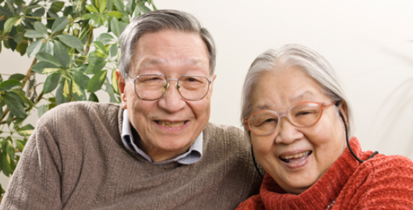
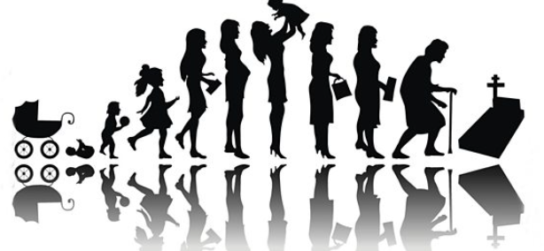
Human Life Span
A1. Physical development
Later Adulthood (65-plus years)

Slide 2
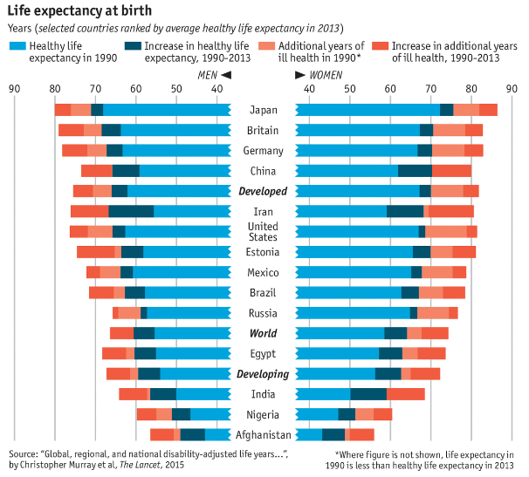
Life expectancy in the UK
2017 Average life expectancy of
woman is 82.9 years
and of men is 79.2 years
http://oldestinbritain.nfshost.com/living.php

Slide 3
Why do we age?

Slide 4
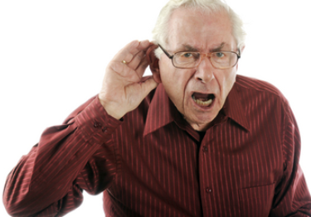
Deterioration of senses; hearing
Hearing loss is the result of sound signals not reaching the brain. There are two main types of hearing loss, depending on where the problem lies.
Sensorineural hearing loss is caused by deterioration to the sensitive hair cells inside the inner ear or damage to the auditory nerve.
Conductive hearing loss happens when sounds are unable to pass from your outer ear to your inner ear, often because of a blockage such as earwax which occurs in older age

Slide 5
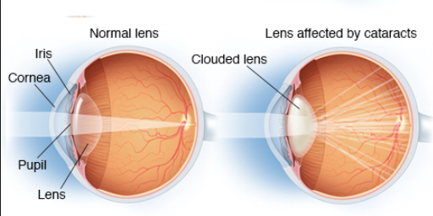
Deterioration of senses; sight
Visual impairment is caused by a number of problems but it in old age it tends to be the weakening of muscles that help us to see close to or distance. Peripheral vision isn’t as good as it use to be and the optical nerve ages.
Health issues regarding eyes increase such as cataracts.

Slide 6
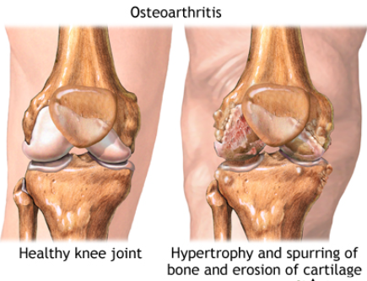
Mobility Issues
Flexibility in joints, cartilage wastage and injuries can limit movement in older people and make it painful. Further loss of stamina and strength in muscles slow down and restrict movement and injuries take a long time to heal. Balance and coordination become more challenging which all impacts on an older persons independence and mobility.

Slide 7
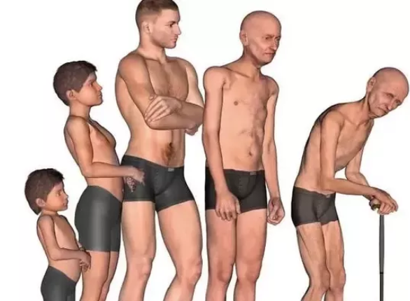
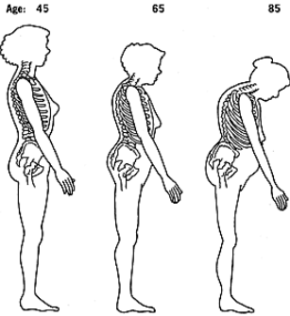
Loss of height
Cartilage becomes worn, brittle and gets less, and your spine is 1 third cartilage, so height is lost as the spine compacts. In addition the spine curves and older people stoop more.

Slide 8
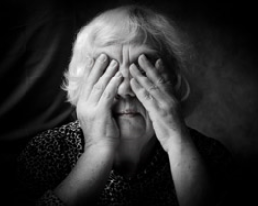
Incontinence problems
Weakened muscles at the bladder entrance and the anus causes leakages and the inability to hold on to urine or faeces for long periods.
Males experience enlarged prostates with age so bladder size shrinks and urination is frequent. Older people often worry how close they are to a toilet or require pads or a catheter.

Slide 9
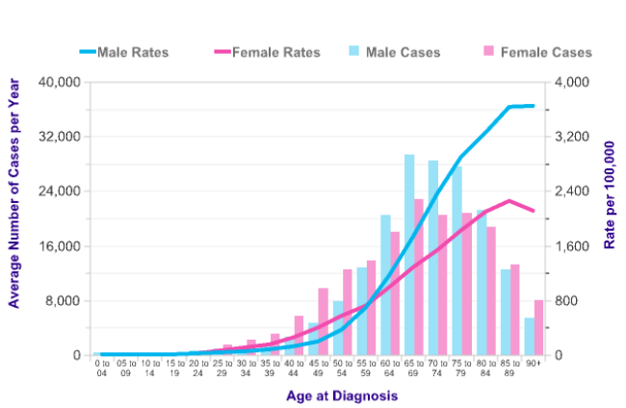
With age comes the increase risk of cancers

Slide 10
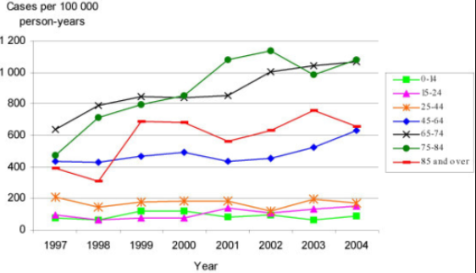
Old age and ill health
Immune systems gets weaker, flu jabs are offered
Injuries take longer to heal and so are open to infection longer
Poor life style choices; obesity, smoking, drinking lead to greater chances of heart disease and diabetes
Kidney filtering systems deteriorate and don’t renew

Slide 11
Intellectual abilities
Make notes as you watch this video- it’s not all bad!
Read page 11 &12 in the text book and make your own notes.

Slide 12
Read page 11 &12 in the text book
Deterioration of intellectual abilities I read this section in the book and make notes

