Slide 1
What is Health? What factors effect Health?
Learning Aim A
Outcomes:
PIES
Factors

Slide 2
P.I.E.S.
Learning Aim A
What do we mean by:
Physical Health
Intellectual health
Emotional Health
Social Health?

Slide 3
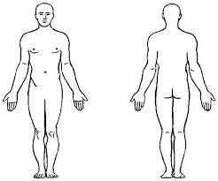
P.I.E.S
Learning Aim A
Physical | Intellectual | Emotional | Social
Our bodies | The way we think | The way we feel | Our relationships

